Slide 1
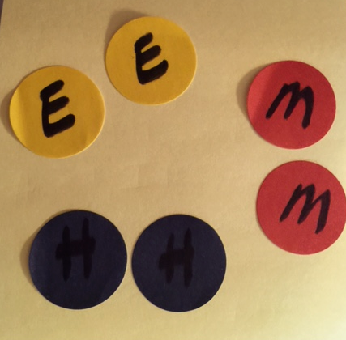
Please sit at a table with
2 elementary,
2 middle school and
2 high school teachers from at least 3 different districts.
Elementary
Middle School
Elementary
TABLE GROUP
Middle School
High School
High School

Slide 2


CKEC Social Studies Content Leadership Network
March 24th, 2015
All materials for today’s meeting can be found at
http://www.debbiewaggoner.com/mar-2015-social-studies.html

Slide 3
CKEC Social Studies
Facilitation Team
Debbie Waggoner, KDE/CKEC Social Studies Instructional Specialist
Laura Smith, Instructional Coach, CKEC/CKSEC
Terry Rhodes, KDE/CKEC Science Instructional Specialist
Krista Hall, KDE Instructional Consultant
Maurice Chappell,
Director of Implementation & Innovation,
Jessamine County Schools
Rebecca Mueller,
Doctoral Student, University of Kentucky
Today’s materials can be accessed at: www.debbiewaggoner.com/mar-2015-social-studies.html

Slide 4





















Learning
Teaching
Enhancing
Supporting
Sharing
Burgin Independent School
Over 100 years of Excellence

Slide 5


PGES - Professional Growth and Effectiveness System

Slide 6
CKEC SS Network AGENDA TUES March 24th
--Welcome, Intro, Targets, Willing to be Disturbed article
--Whole group Distilling the Standards Protocol – go over the sample protocol as an example, then complete one Elem, one MS, one HS standard at each table
--Grade Level Break-Outs Complete Progression for you Grade Band K-5, 6-8, 9-12.
--Whole group sitting in district teams – share out progressions from grade band work, discuss ideas for sharing protocol in your district, Homework - determine who from your district will be attending summer meetings on which days
--LUNCH review Inquiry Cycle
--Grade Level Break-Out rooms:
Review what we have completed so far in the Inquiry Cycle
–column one: questioning How have you been using the QFT protocol in your classroom? Review assigned reading homework to finish the green QFT book,
--column two: evaluating sources – Review assigned homework - what evidence of student mastery of evaluating sources did you bring?,
--column three: Argumentation as part of Communicating – how do you teach argumentation and how do teach kids to critique each others’ arguments?
--Review today’s targets, complete online Evaluation

Slide 7

Norms:
Respect
Cell phone
Engagement
Restrooms
Being Prepared
Side Conversations
Use Technology to enhance your day

Slide 8
Social Studies Network Meeting
IMPORTANT NOTES
PINK Sheet
What do I want to remember? | How will I use this information, and how will I share it with others in my district?
Notes:
As always, we have your reflection sheet for you to record your thoughts and ideas throughout the meeting.
(Read Reflection questions)

Slide 9
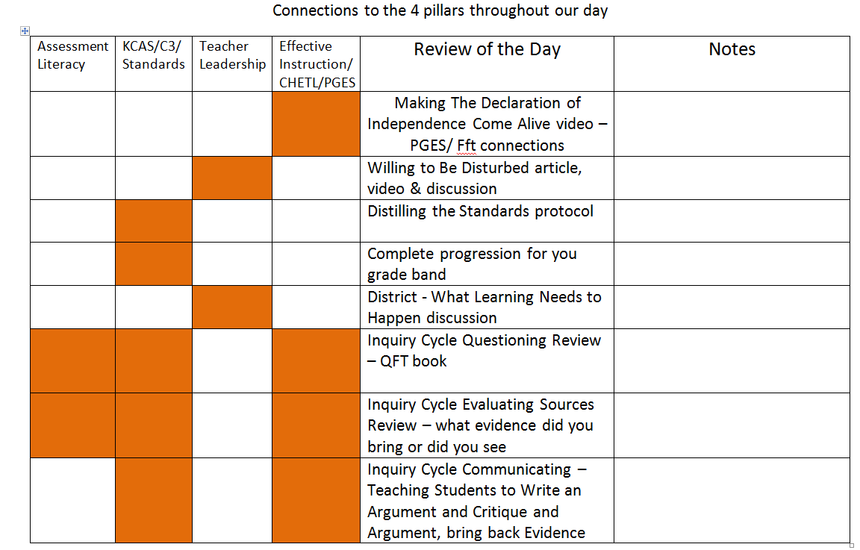

Slide 10
Update on SS Standards (Mar. 2015)
Revisions have been occurring as a result of public and focus group feedback.
  The majority of responses (approx. 80%) were to make NO changes to the existing draft.
Supplementary resources (appendices) are in the works:
  Curriculum considerations documents for K-8 (See Kindergarten copy)
  High school suggested course options – tradition vs. integrated
  K-2 Integrated unit samples
  Glossary
Ky. BOE to have second read in June.
  Statement of Considerations presented in August with KDE rationale regarding decisions around public feedback.
Implementation still planned for Fall 2015

Slide 11
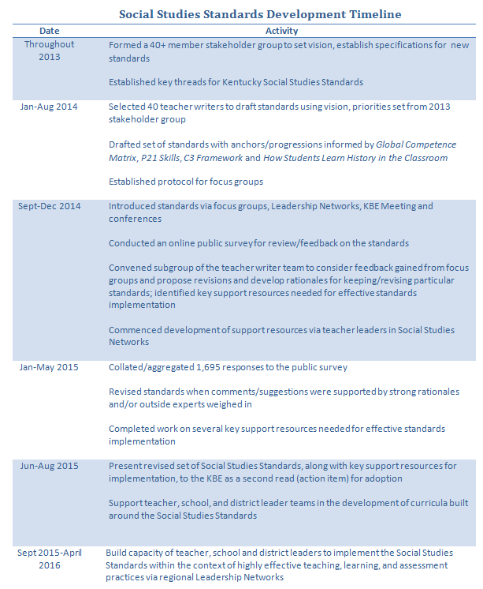

Slide 12
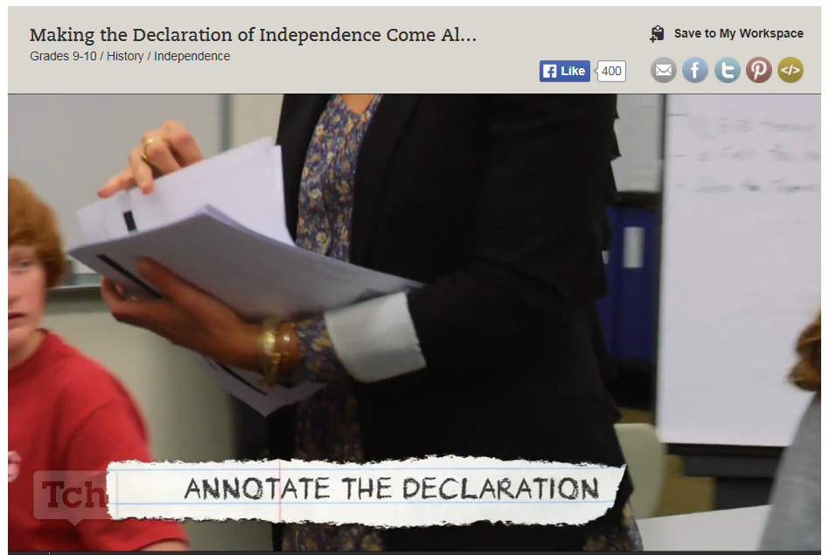
Connecting to CHETL/PGES/Framework for Teaching
Focus on one page from the Framework for Teaching: 1E, 2B, or 3C while you are
watching the video. Look for evidence in the video that corresponds to the page you
are reviewing. Make sure all three pages are represented at Your table.
Be ready to discuss the evidence you see after the video.
Notes:
https://www.teachingchannel.org/videos/teaching-declaration-of-independence

Slide 13
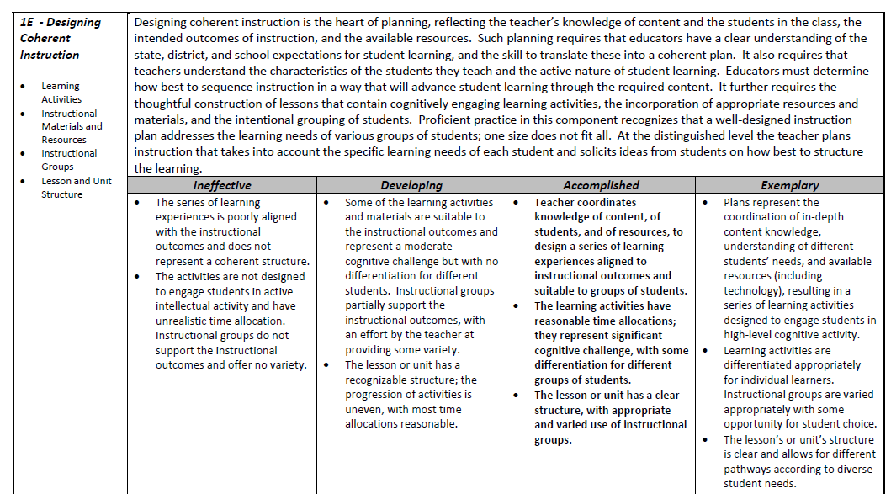
Focus on one page from the Framework for Teaching: 1E, 2B, or 3C while you are
watching the video. Look for evidence in the video that corresponds to the page you
are reviewing. Make sure all three pages are represented at Your table.
Be ready to discuss the evidence you see after the video.

Slide 14
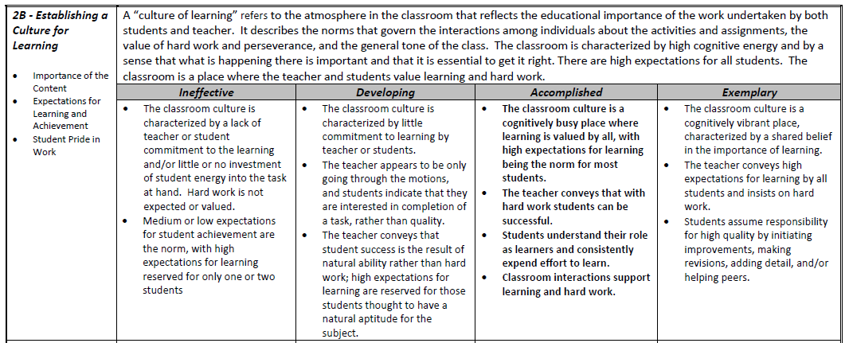
Focus on one page from the Framework for Teaching: 1E, 2B, or 3C while you are
watching the video. Look for evidence in the video that corresponds to the page you
are reviewing. Make sure all three pages are represented at Your table.
Be ready to discuss the evidence you see after the video.

Slide 15
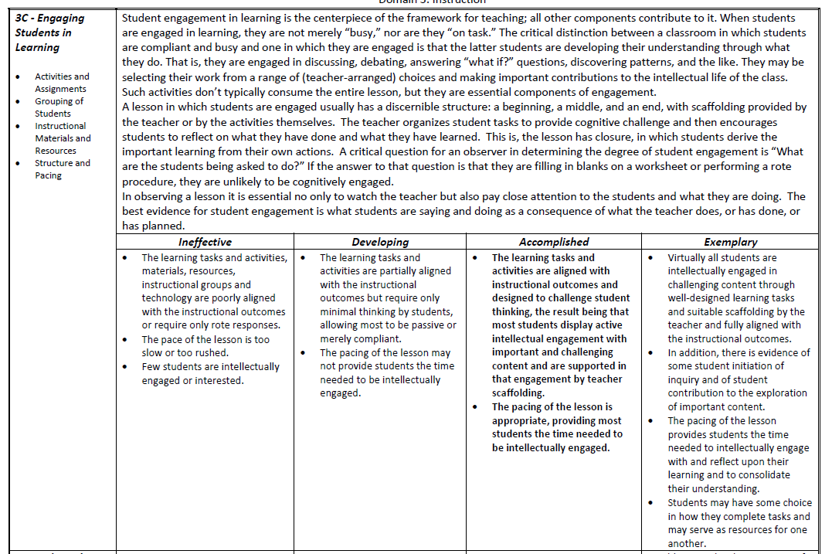
Focus on one page from the Framework for Teaching: 1E, 2B, or 3C while you are
watching the video. Look for evidence in the video that corresponds to the page you
are reviewing. Make sure all three pages are represented at Your table.
Be ready to discuss the evidence you see after the video.

Slide 16
Are you Willing to Be Disturbed?
Read the short one-page passage.
While reading, highlight the one statement that resonates with you.
Video Clip “I remember” by Intel
http://www.youtube.com/watch?v=8i0iPphcgtU
Beginning with the person at your table whose birthday is closest to Easter, share your statement.
Discuss with your table group the implications this video and the Are you willing to be disturbed? passage have on:
  the need for the new focus on social studies standards for the next generation and
  your role as a social studies leader in your school and district to help prepare teachers for this shift…
16
Notes:
The amount of new information we each come in contact with daily is greater than at any time in history.
We can’t expect to keep doing things the same way and keep up, we have all ourselves to be disturbed so we can learn from one another.
This video shows how the world has already changed just in the time these young kids have been alive.

Slide 17

Target
Participants can distill content from draft standards through a process for curricular design.

Slide 18
Modeling a Protocol for Distilling Content from Standards
Architecture Study
Anchor
Grade-level Narrative
Grade-level Standard
Context Examples
Connections

Slide 19
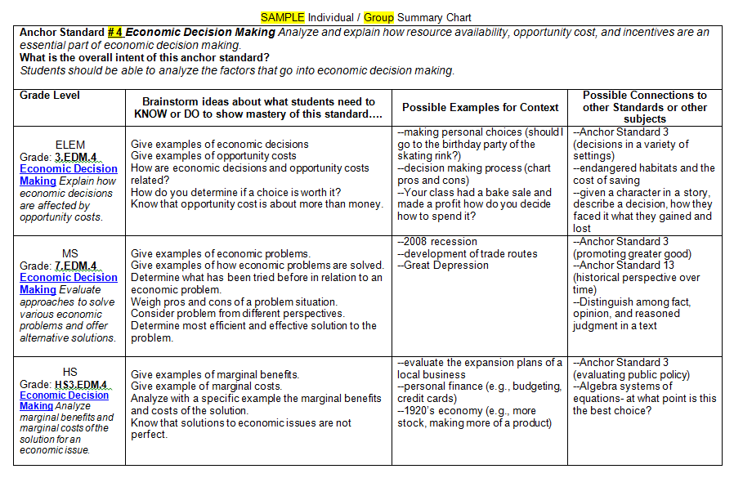

Slide 20
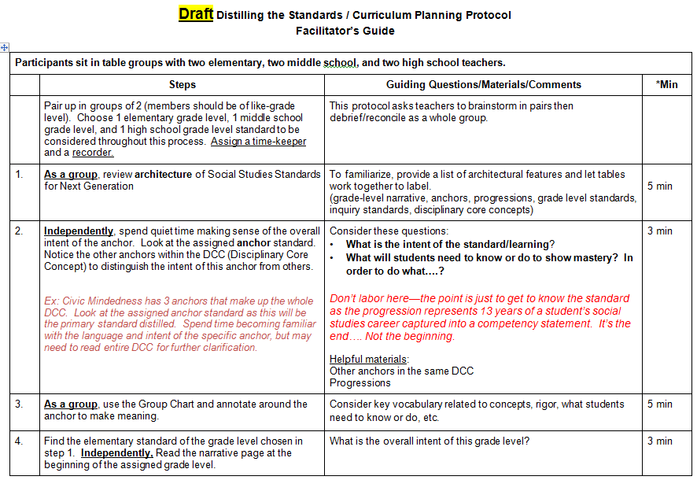
Work through steps 1-8 of the PROTOCOL with your table group

Slide 21
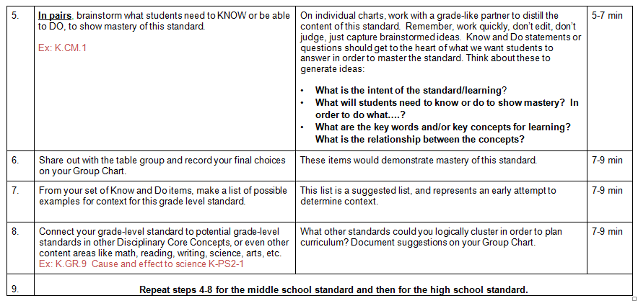
Work through steps 1-8 of the PROTOCOL with your table group

Slide 22

Spend time with
posters and talking
with others

Slide 23
Grade Level Groups –
Use the Distilling Content Protocol to
distill content from all the grade level
standards in your grade band for
Anchor Standard 10.
Elementary: K-2 and 3-5
Middle School: grades 6-8
High School: HS1, HS2, HS3, HS4

Slide 24

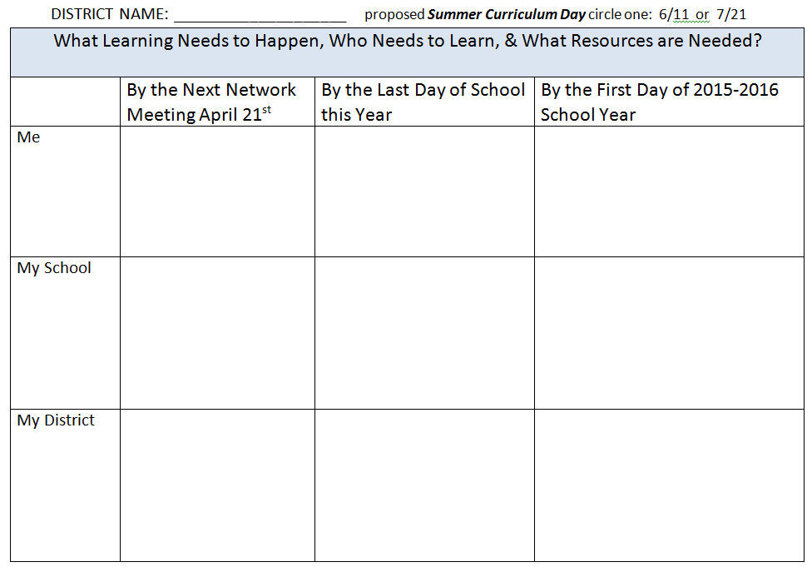
Please sit with your DISTRICT TEAM
What capacities are in place to make curricula decisions?
How do we prepare our district, school, and team to write SS curriculum?
Take a picture for your records
& turn in once finished

Slide 25
CKEC Summer SS Network
Thurs. June 11th | Tues. July 21st | Thurs. July 23rd
Curriculum Planning Day | Curriculum Planning Day | Joint Science and Social Studies LDC Day
When is your district team
going to attend?

Slide 26
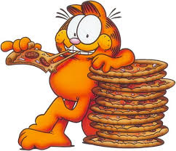
Lunch

Slide 27
Kentucky Rising FACT Sheet
Kentucky Rising establishes criteria for a high school diploma, certificate, or endorsement that certifies a graduate meets the employment requirements of foreign industries that are directly investing in the state and industries that are creating trade with other countries.
By ensuring Kentucky’s workforce is an asset to global development, Kentucky can continue to create jobs for residents that grow the state’s economy. “Global ready diploma”
Kentucky Rising both supports and intersects with ALL content areas, especially social studies. An emphasis on Kentucky Rising as an intentional focus aligns the rigor of KCAS, PGES, 21st Century Skills and Program Reviews while developing a skilled and highly adaptable workforce.

Slide 28
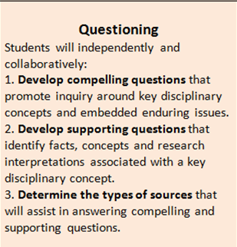
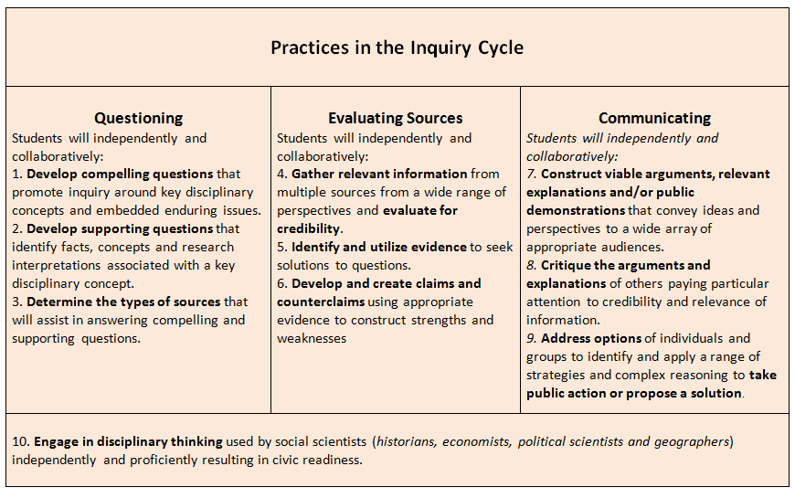
Focus on Inquiry enhances classroom practice…
Grade Level Groups –

Slide 29
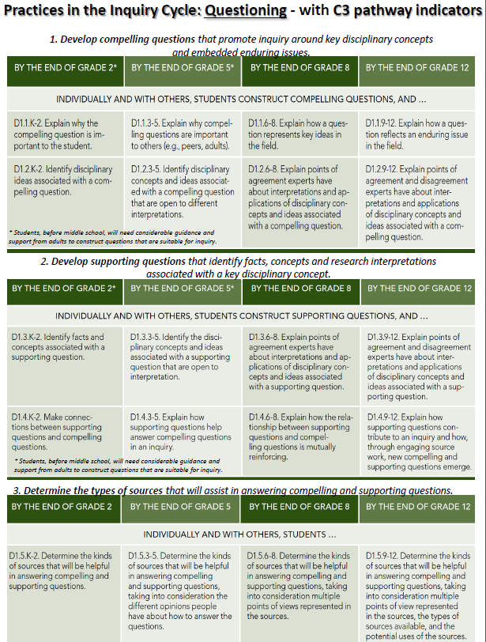

Defensible Evidence of Inquiry Standards 1-3
Grade Level Groups –

Slide 30
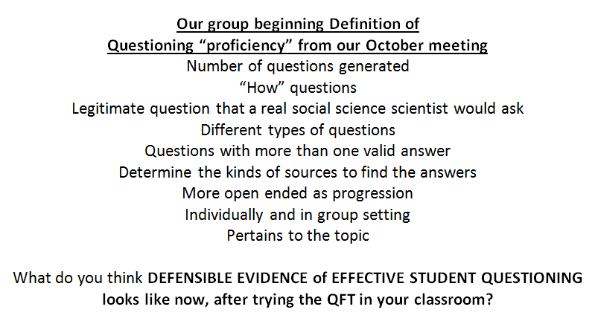
Grade Level Groups –

Slide 31
Grade Level Groups –
--HOMEWORK REVIEW (from our November meeting):
--Read selected chapter from the green QFT book:
-Chapter 8 Students Reflect on Their Learning pg119-126
-Chapter 10 Students and Classrooms Transformed pg135-147
-Conclusion Questions and Education, Questions and Democracy pg149-156
Use either the Question Journal pg167 or the GIST pg184 reading strategy from red book as you read (yellow paper)
Have you tried either of these reading strategies (Question Journal or GIST) with your students?
How have you used the QFT in your classroom
since our November meeting? How did it go?

Slide 32
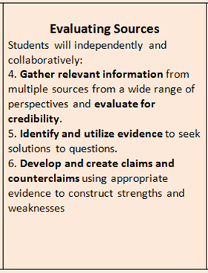
Focus on Inquiry enhances classroom practice…
Grade Level Groups –

Slide 33
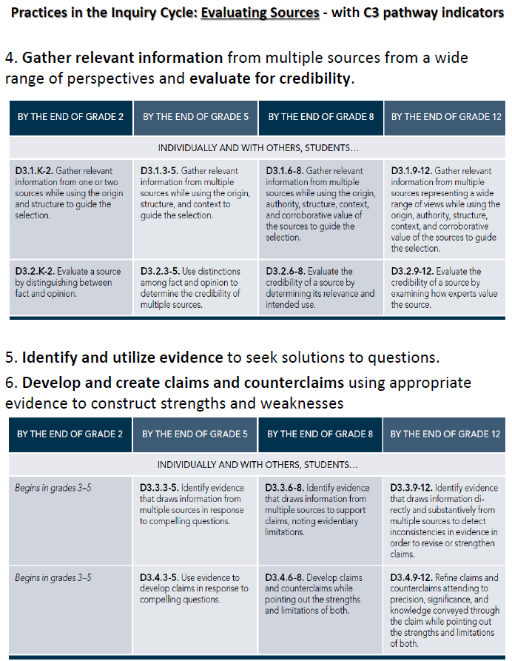
Grade Level Groups –
--HOMEWORK REVIEW
(from our November meeting):
--Bring DEFENSIBLE EVIDENCE of student’s effective Evaluation of Sources - What evidence did you bring
or have you observed in your students?
Defining Defensible Evidence:
Mastery of Evaluating Sources

Slide 34
proficient level of “evaluating sources”
Grade Level Groups –
Identify the context written or spoken
Point out any bias in the document
Recognize the purpose
Actually be able to read and/or understand the document
Be able to compare and contrast
Using multiple sources as evidence not just one source
Gather their own sources (depends on grade level) or choose the best sources among a selection of sources
Credibility of the source – primary or secondary source

Slide 35
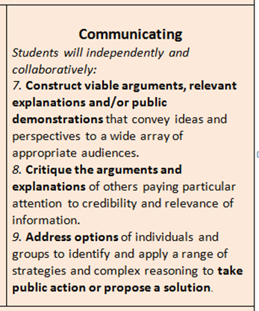
Focus on Inquiry enhances classroom practice…
Grade Level Groups –

Slide 36
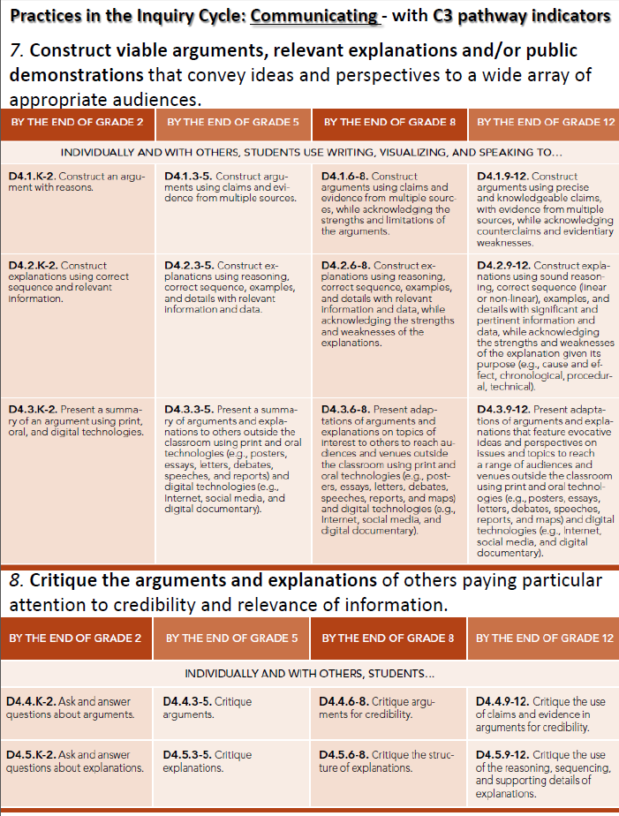
Grade Level Groups –
Defining Defensible Evidence:
Mastery of Communicating -
Constructing Viable Arguments and Critiquing Arguments of Others

Slide 37
Defining Defensible Evidence:
Mastery of Communicating - Constructing Viable Arguments and Critiquing Arguments of Others
Grade Level Groups –
Defensible Evidence: examples from instructional practice that can be defended as mastery of a skill.
Using today’s learning and resources, brainstorm what is proficient level of Evaluating Sources (for your grade band)?
Can you affirm or revise the criteria from the FfT?
What evidence can you provide from your classroom that students are mastering the art of evaluating sources?
Bring DEFENSIBLE EVIDENCE of EFFECTIVE STUDENT Communicating - Constructing Viable Arguments and Critiquing Arguments of Others to the APRIL meeting
Notes:
What’s our grade band definition of proficiency of Evaluation Sources?

Slide 38

HOMEWORK
Grade Level Groups –
Who will attend the summer curriculum
planning meetings from your district and
what day(s) will you attend?
Bring DEFENSIBLE EVIDENCE of EFFECTIVE student Communicating: Constructing Viable Arguments and Critiquing Arguments of Others
to the APRIL meeting

Slide 39

Grade Level Groups –
Review of the day:
Please complete the online evaluation
before you leave.
We need your feedback!

Slide 40
CKEC Social Studies
Leadership Network 2014-2015
Grade Level Groups –
NorthEast Christian Church
8:30am-3:30pm
Tues. Sept. 30th, 2014
Tues. Oct. 21^{st,} 2014
Mon. Nov. 24th, 2014
Tues. Mar. 24th, 2015
Tues. Apr. 21st, 2015
Summer 2015: June 11th, July 21st, July23rd
See you next month on Tues, April 21st, 2015

Slide 41

GO BIG BLUE! #BBN #WeAreUK #PursuitOfPerfection #TimeForNINE

