Slide 1
Student Growth Goal-Setting Scenario
Rebecca Woosley, Effectiveness Coach
Kelly Philbeck, LDC/ELA Instructional Specialist Oct. 16, 2014
Notes:
We know you are in the process of coaching teachers as they set their student growth goals. Because of questions from many of you, we are going to look at a draft of a social studies scenario where the teacher uses LDC as the basis for his student growth goal. Our focus to day will be the steps in the process this social studies scenario illustrates.

Slide 2
Today’s Targets
the process (HOW the teacher collected and used data for SG)
the decisions the teacher made (WHAT he did)
the rationale (WHY he made those decisions)

Slide 3
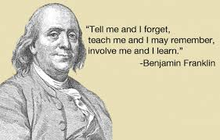
Let’s look at a social studies scenario
Mr. Diamond, a World History teacher at
Ben Franklin HS

Slide 4
Step 1: Determining Needs
Step 1:
Determine needs
Step 2:
Create specific learning goals based on pre-assessment
Step 3:
Create and implement teaching and learning strategies
Step 4:
Monitor student progress through ongoing formative assessment
Step 5:
Determine whether the student achieved the goals
Notes:
Step 1 in the goal setting process is Determine Needs.
We find out what the needs of the students are by examining data that provides evidence of those needs.
Having the right sources of evidence is key in identifying what skills students need to develop across the year.
Remember, we are goal-setting for the year or a course. It’s not about a module or even a unit assessment, but rather skills and concepts that students continue to develop all year and are important enough for students to monitor across the year.
The assessments/sources of evidence we choose need to be standards-based so they can provide baseline data about student mastery of those standards.

Slide 5
What did Mr. Diamond’s PLC do first?
Enduring Learning –
ENDURES beyond a single test date
is of value in other disciplines
is relevant beyond the classroom
is worthy of embedded, course-long focus
may be necessary for the next level of instruction
Notes:
Q – What did Mr. Diamond’s PLC do first?
A – They identified their content area enduring skills. They used the ES process designed to help them identify those skills from their standards.
Just as a reminder – let’s look at how we define enduring learning.
Remember, teacher are asked to goal-setting for the year or a course. It’s not about just the length of a module or even a unit assessment, but rather skills and concepts that students continue to develop all year and are important enough to monitor across the year.
Using this definition of enduring learning helps teachers make appropriate choices for the enduring skill/learning that is the basis of their SGG.
Now – let’s look at the enduring skills did Mr. Diamond and his PLC identified.
(see next slide)

Slide 6
Enduring Skills/Learning Mr. Diamond’s PLC identified:
Construct compelling and supporting questions to develop inquiry skills
Use evidence to support a claim
Evaluate the credibility of sources
Communicate conclusions to a range of audiences
Critique own work as well as the work of others
Take informed action
Notes:
It’s important to note that these enduring skills were identified in collaboration with others, not independently.

Slide 7
Determining the baseline and growth measure
What did Mr. Diamond plan to use for his baseline data and growth measure?
How did he arrive at the decision?
Notes:
Q – Look again at the scenario; what did Mr. Diamond plan to use for his baseline data and growth measure? How did he arrive at the decision?
A - see next slide

Slide 8
LDC Classroom Assessment
Allows for pre-assessment baseline data using one of the LDC rubrics
Allows formative and end of year post-assessment data
Uses the same template as the teaching task in the LDC module
Notes:
A - Mr. Diamond’s PLC decided to use data from an classroom assessment task (on-demand task) they planned to give, as well as the data from the mini-tasks embedded in the instructional ladder of the LDC module as sources of evidence for their baseline data. (NOTICE: the assessment task they used is included in your packet.)
Within the LDC module design is the choice of a classroom assessment. Teachers use the same template task that they will use as they implement their module but design for a response written in a short period of time (similar to an on-demand assessment).
The assessment will provide baseline data on where students are in meeting specific standards. The LDC rubric is standards-based and differentiates skills level for several reading & writing standards.
Post assessment at the end of the unit (in which the module fits) can provide formative assessment data. Post assessment data at the end of the year or course can provide summative data on where students are in meeting the targeted standards.

Slide 9
Notes:
This is an example of how Mr. Diamond recorded the results from scoring his student work with the LDC argumentation rubric, so he could determine overall performance levels for his baseline data. (Participants have the complete document in their packet.)
Notice - he was looking for patterns in the data related to his enduring skill.

Slide 10
LDC Classroom Assessment Task
(Results of the first LDC Classroom Assessment Task)
Scoring Elements | Not Yet 1 | Approaches Expectations 2 | Meets Expectations 3 | Advanced 4
Focus | 0% | 15% | 80% | 5%
Controlling Idea | 30% | 66% | 3% | 0%
Reading/ Research | 13% | 73% | 13% | 0%
Development | 33% | 33% | 33% | 0%
Organization | 0% | 10% | 90% | 0%
Conventions | 15% | 15% | 65% | 5%
Content Understanding | 10% | 15% | 75% | 0%
Notes:
Let’s take a look at the data from Mr. Diamond’s LDC classroom assessment task.
Q – He’s highlighted 3 areas. What does the data in those areas tell him about his students abilities?
Why do you think he didn’t highlight the other areas?

Slide 11
Assessments from Instructional Ladder
of the 1st LDC Module
Instructional Ladder | Meets Expectations
Preparing for the Task | 100%
Reading Process | 45%
Transition to Writing | 40%
Writing Planning & Development | 40%
Revision and Editing | 30%
Notes:
Let’s look at the assessments used for the mini-tasks from the instructional ladder for the first module that Mr. Diamond taught at the beginning of the year.
Q – How can this data contribute to his baseline?
A – He looked at the specific mini-tasks aligned to the scoring elements he highlighted in the data from the classroom assignment. The evidence from those specific mini-task assessments from his first module, combined with the data from the first classroom assessment, provided the additional evidence he needed to confirm that students, as a whole, struggled with using historical evidence to support a claim/argument. The evidence also confirmed that students also struggled with the ability to evaluate the credibility of a source.
This teacher determined his baseline data using the 3 scoring elements he highlighted on the LDC argumentation rubric. He also used the grade-band expectations that support this skill from his standards.
Mr. Diamond saw an important connection between that skill and students’ ability to evaluate the credibility of a source, so decided he would include instruction for that skill as well. As a result, he planned to collect corroborating evidence as he measured students’ improvement in their ability to use historical evidence to support a claim improves.

Slide 12
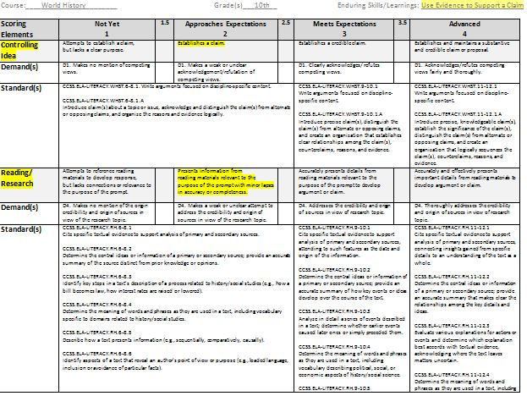
Notes:
Q – What do you notice that is different about this version of the rubric Mr. Diamond and his peers in his PLC are using?
A. – He embedded grade level standards.
Q - Why do you think they embedded grade level standards? Why in those places?
A - He did this because he wanted to focus on what that skill looks like at the grade level he teaches. Mr. Diamond’s PLC did this by embedding the grade level standards, that he identified as his goal targets, immediately under the criteria listed in the rubric.
Notice, Mr. Diamond highlighted the target skills on the rubric.

Slide 13
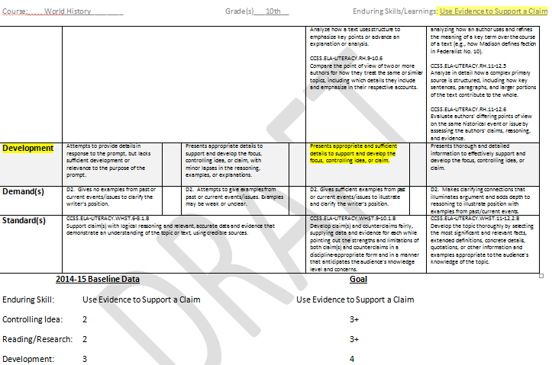
Notes:
The data at the bottom of the page illustrates how the baseline data informs the goal.

Slide 14
Notes:
This is another way of looking at how he used this data to help him see where the evidence fell on the rubric, which helped him make baseline decisions.

Slide 15
Step 2: Creating the Student Growth Goal
Step 1:
Determine needs
Step 2:
Create specific learning goals based on pre-assessment
Step 3:
Create and implement teaching and learning strategies
Step 4:
Monitor student progress through ongoing formative assessment
Step 5:
Determine whether the student achieved the goals
The teacher creates a student growth goal built on the baseline data collected and analyzed in Step 1.
Notes:
In Step 2, a teacher creates a student growth goal built on the baseline data collected and analyzed in Step 1.
Although teachers create a goal based on need, keep in mind that it is important for students to understand the goal, the purpose of the goal, and their role in achieving it.

Slide 16
What is a Student Growth Goal?
Goal … a statement of an intended outcome of your work:
Student Learning
Distinct from Strategies
Strategies = Means
Goal = End (the intended outcome)
Notes:
A student growth goal is a statement about the intended outcome of your planned and implemented instruction across the course – not just for a module or for a unit.
Note that goals are different from strategies. Strategies are the means and goals are the ends (the outcomes we hope for).

Slide 17
Kentucky Department of Education
Professional Growth and Effectiveness System
Student Growth Goals Basics…
Specific, Measureable, Appropriate, Realistic, Time-Bound
SMART goal
Proficiency component & Growth component
One classroom of students, one content area
___% of students will reach the level of proficiency as determined by…
All of my students will grow at least _____.
3rd Grade math students
1st period 7th grade language arts students
6th period high school concert band students
Notes:
There are 3 important components to include in a quality student growth goal.
The goal meets the SMART criteria.
The goal includes a growth statement/target that articulates the enduring skill, concept or process, as well as the expected growth for all students.
The goal includes a proficiency statement/target that indicates the percentage of student who will reach proficiency.

Slide 18
Mr. Diamond’s SGG
For the current school year, all of the 10th grade world history students in my 3rd block class will make measurable progress in the enduring skill, use evidence to support a claim. All students will move up at least 1 level in each of the three scoring elements and 75% of students will achieve at the 3 or higher level on the controlling idea, reading/research, and development areas of the LDC Argumentation Rubric.
Notes:
Together, Mr. Diamond and his principal reviewed the data and collectively agreed upon his goal.
NOTE: It is important to note that Mr. Diamond needed to share the enduring skills with his principal in combination with the data he had collected and analyzed.
What you see in Green is the growth target.
What is in Red is the proficiency target.
In Purple you see the enduring skill clearly articulated.
How he will measure both the growth and the proficiency target is in blue.

Slide 19
Step 3: Creating & Implementing Strategies (What skills/instruction?)
Step 1:
Determine needs
Step 2:
Create specific learning goals based on pre-assessment
Step 3:
Create and implement teaching and learning strategies
Step 4:
Monitor student progress through ongoing formative assessment
Step 5:
Determine whether the student achieved the goals
Notes:
Step 3 Create and implement teaching and learning strategies. Notice that What skills/instruction is in red.
Ask participants what why that is a reference? (That refers to those elements in and LDC module.)

Slide 20
Start by deciding on instructional strategies for goal attainment
19
Notes:
There are many instructional decisions that will impact goal attainment.
Deciding on the best instructional strategies for goal attainment requires thoughtful planning and adjustments based on daily evidence of student learning throughout the year.

Slide 21
Carefully chosen strategies are…
supported by research
developmentally appropriate
appropriate for the subject matter
20
Notes:
Dr. Stronge provides 3 fundamental criteria to apply when choosing instructional strategies:
Carefully chosen strategies are supported by research.
While education journals are not the only source of research-based strategies, they do provide on-going insights and evidence to inform teacher decisions about instructional strategies fundamental to all learning and specific to your content area.
2. Carefully chosen strategies are developmentally appropriate for the target students.
As you get to know your students and pre-assess in Step 1 of the goal-setting process, you will have evidence to determine where your students are developmentally as learners. It's important to use those insights when you choose instructional strategies for YOUR students. As the pictures under the second bullet on the screen illustrate, in art, for example, the strategies used to develop the fundamental skills of early learners, will be more refined when targeting the growth of a high school student whose skill are already developed well past the fundamentals.
3. Finally, carefully chosen strategies are appropriate for the subject matter.
There are some research-based instructional strategies that are foundational for all learners.
For example:
- engineering effective classroom discussion, questions and learning tasks
- providing feedback that moves learners forward
- activating students as owners of their own learning
- activating students as instructional resources of one another
It’s important to note here that these strategies align with Domain 3 – Instruction. Within that Domain, they align with 3B –Questioning and Discussion Techniques, 3C – Engaging Students in Learning, and 3D – Using Assessment in Instruction.
These apply to all content and all grade level, however, the instructional strategies that will be used by a history teacher to help his students delineate argument when students are listening to a speech or reading an article, will be different from the strategies used in the chemistry class when students are combining chemicals and drawing conclusions about the implications, because they will be selected to support students in the process of content-specific learning.

Slide 22
Some Places to Look
PD 360
Teaching Channel
LDC Core Tools
Other teacher experts, coaches

Slide 23
Coming in November... Step 4: Monitoring Student Progress and Making Adjustments
Step 1:
Determine needs
Step 2:
Create specific learning goals based on pre-assessment
Step 3:
Create and implement teaching and learning strategies
Step 4:
Monitor student progress through ongoing formative assessment
Step 5:
Determine whether the student achieved the goals
Notes:
Step 4 – Well focus on monitoring progress in November…
Monitor progress throughout the year, checking assessment data at mid-year and end of the year.
Formative assessments provide multiple data points throughout the year- provide data so we continue to know where students are and our assessment of students is more valid

