Slide 1
World Languages Global Competence
Alfonso De Torres Nunez, World Language Consultant
Robert Duncan, lead consultant Program Reviews
Kelly Clark, lead consultant Global Competency
By PresenterMedia.com

Slide 2
ARE YOU READY?
Notes:
We will start first with a video → connection to Stacie Berdan

Slide 3
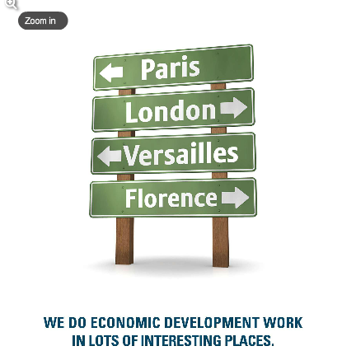
Why Kentucky?
Notes:
Let’s set the scenario. Why Kentucky? How is Kentucky globally connected?

Slide 4
Did you know…?
Based on the Mar. 10th 2015 report of the KY Cabinet of Economic Development:
There are 438 facilities with foreign ownership
There are 86,751 full-time jobs tied to those facilities
Three examples: There are 170+ facilities tied to Europe, 160+ to Japan and 10+ to Mexico
Notes:
KY Cabinet of Economic Development

Slide 5
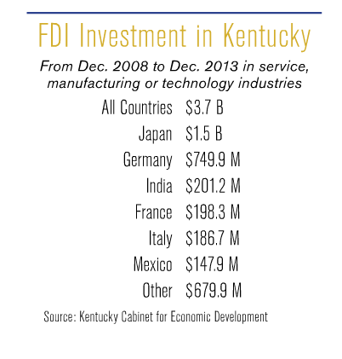

Slide 6
Did you know…?
From the US Department of Commerce, just in 2013 (awaiting for all year results from 2014):
Kentucky ranked 2nd in the nation among states for percentage export growth and 8th in the U.S. for exports on a per capita basis.
Kentucky exports totaled a record $25.285 billion in 2013.
Kentucky ranks 18th in the nation in total exports.
Kentucky’s total exports increased by 14.3% or $3.16 billion from 2012 to 2013.
Manufactured goods accounted for nearly 98.5% of all Kentucky exports in 2013.
Kentucky exported to 198 countries during 2013.
Top export industry sectors in Kentucky include: Aerospace,
motor vehicles, synthetic fibers, pharmaceuticals, and basic chemicals.
Canada, Mexico, the United Kingdom, China, Brazil, Japan, France,
and Germany are Kentucky’s top export markets.
Notes:
US Department of Commerce

Slide 7
Did you know…?
Examples of facilities with foreign ownership in the region that you lead:
Fayette Co.:
Japan: Accuromm U S A Inc, Funai Corporation, Kito USA, Konoike Transport and Engineering USA Inc, LBX Co LLC, Link-Belt Construction Equipment Company, Nitto Denko Automotive Kentucky Inc, Sumitomo Electric Wiring Systems Inc, Watanabe USA Corporation
Germany: Allylix Inc, Aventics, Webasto Roof Systems Inc
China: Birtley Industrial Equipment, FGX Septech LLC
Republic of Korea: Clark Material Handling Co Parts Warehouse, Clark Material Handling Company
Italy: Florida Tile Inc
United Kingdom: HFL Sport Science Inc, Intertek Testing Services Inc
Switzerland: Kaba Mas LLC
Austria: Loxone Inc
Ireland: Mountain Enterprises Inc, Oldcastle Precast Inc, Pilkington North America, Trane Lexington
France: Schneider Electric
Canada: Stantec Consulting Services Inc
Notes:
KY Cabinet of Economic Development
Report} Kentucky Facilities with Foreign Ownership

Slide 8
Did you know…?
Examples of facilities with foreign ownership in the region that you lead:
Scott Co.
Japan: Aichi Forge USA Inc, Beam Suntory, Green Metals Inc, International Crankshaft Inc, ITS, Kentucky Advanced Forge LLC, Kentucky Smelting Technology (KST), Toyota Logistic Services, Toyota Motor Manufacturing Kentucky, Toyota Tsusho America Inc, Transfreight LLC, Trim Masters Inc, Vascor Ltd, Vuteq Engineering Corp, Vuteq USA Inc, YS Precision Stamping Inc.
Germany: Brenntag Mid-South
Australia: Orica Ground Support
Bourbon Co.
Japan: CMWA, Kentucky Smelting Technology (KST)
Clark Co.
Japan: Advanced Green Components LLC, Ainak Inc, Sekisui S-LEC America LLC, Senko USA Inc, Taica Cubic Printing Kentucky
Netherlands: DSM Nutritional Products LLC
France: Niles America Wintech Inc
Germany: Osram Sylvania
Montgomery Co.
Japan: Kyosan Denso Manufacturing Kentucky LLC (KDMK)
Switzerland: Nestle Prepared Foods
Germany: Vogelsang Corporation
Powell Co.
Germany: Hanson Brick Inc
Notes:
KY Cabinet of Economic Development
Report} Kentucky Facilities with Foreign Ownership

Slide 9
Did you know…?
Examples of facilities with foreign ownership in the region that you lead:
Madison Co.
Japan: AGC Glass Co NA, Asahi Bluegrass Forge Corporation, Asahi Forge of America Corporation, Kokoku Rubber Inc, Richmond Auto Parts Technology Inc
Singapore: A & W Restaurants Inc
Brazil: Quanex Building Products
Canada: Thunder Mfg USA Inc
Jessamine Co.
Japan: TOA SE Inc, Trim Masters Inc
Israel: Albaad fem
Australia: Amcor Rigid Plastics, Medivet America
Garrard Co.
Japan: Hitachi Automotive Systems Americas Inc, Kentucky Steel Center Inc, KI (USA) Corporation
India: Novelis Corporation
Woodford Co.
Japan: Nisshin Automotive Tubing LLC, Pilkington North America, Yokohama Industries Americas Inc/Div 1 &2,
Germany: Osram Sylvania
Australia: McCauley Brothers Inc
Notes:
KY Cabinet of Economic Development
Report} Kentucky Facilities with Foreign Ownership

Slide 10
Did you know…?
Examples of facilities with foreign ownership in the region that you lead:
Anderson Co.
Italy: Florida Tile Inc, Wild Turkey Distillery
Japan: Four Roses Distillery LLC, YKK Snap Fasteners America Inc
Germany: Hanson Aggregates Tyrone Quarry
Mercer Co.
Japan: Hitachi Automotive Systems Americas Inc, Toyota Boshoku Kentucky LLC
Switzerland: Nestle Prepared Foods
Germany: Vogelsang Corporation
Boyle Co.
Japan: Denyo Manufacturing Corp, Panasonic Appliances Co of America
United Kingdom: Intelligrated Inc, Meggitt Aircraft Braking Systems Kentucky Corporation
Nelson Co.
Japan: American Fuji Seal Inc, FET Engineering Inc, INOAC Packaging Group Inc, Johnan America Inc, Mitsuba Bardstown Inc, NPR of America Inc, TBKY Inc
Canada: Polyair Corporation
Washington Co.
Japan: INOAC Group North America, Toyotomi America Corp
Marion Co.
Japan: Curtis-Maruyasu America Inc, Fuel Total Systems Kentucky Corporation, NSU Corporation, TG Kentucky LLC, Toyota Boshoku Kentucky LLC, US Chita
France: Canton Wood Products LLC
Canada: Montebello Packaging Inc
Notes:
KY Cabinet of Economic Development
Report} Kentucky Facilities with Foreign Ownership

Slide 11
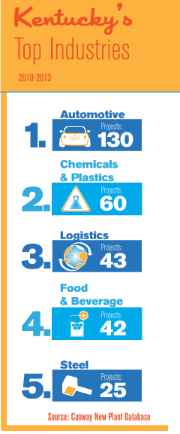
QUIZ
What are the top Kentucky industries in number of projects? (2010-2013)
Please, be fair and do not google the answers
When people think Kentucky, they don’t jump to industry or manufacturing right away. (Besides coal and horses)
Notes:
Chances are, neither do most of our students
But this is where the work is -

Slide 12
Ripped from the headlines in the last three months….
Electrolux to buy GE Appliances Business for $3.3 billion deal that positions Swedish group to challenge Whirlpool as the leader in sector's U.S. Market
Lexmark makes offer on Swedish software company
Kentucky & China collaborate on a large-scale carbon capture project
Lincoln MKC brings 300 new jobs to Louisville Assembly Plant
Ford Motor Co. invests $129 million in Kentucky
Notes:
Last year 40 percent of new investment and about 30 percent of jobs created in the state came directly from foreign companies, showing that it's not a niche area for the state.
433 companies from more than 30 nations doing business in Kentucky translates to about 85000 jobs.
Ford has global operations that employee 166000 workers in 80 locations
As a comparison- data for the number of coal workers in all of KY in 2012? Just under 17,000

Slide 13
Mapping the Nation www. mappingthenation.net
Notes:
Go on the site and click around – great comparisons and infographics

Slide 14
BE AWARE!!! Global Competency isn’t Only about teaching world language….
LET ME ASK YOU A QUESTION…
USING THIS DATA:
Are we preparing our students for the world that they will find once they graduate?
Some of them will choose college, some others they will join the work force.
Are we providing them with the skills to function in this world?
ARE WE PREPARING THEM TO BE
GLOBALLY COMPETENT?

Slide 15
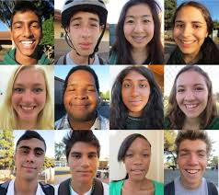
It’s about essential skills for students
Understanding.
Investigating.
Connecting.
Integrating.
Notes:
These soft skills don’t live in world language or social studies alone – they are embedded in every content area

Slide 16
What is Global Competency?
From a NATIONAL EDUCATION
ASSOCIATION policy brief
on the issue:
In depth knowledge and understanding of international issues
An appreciation of and ability to learn and work with people with diverse linguistic and cultural backgrounds
Proficiency in a foreign language
Skills to function productively in an interdependent world community
Notes:
Give out global competency matrix for content areas

Slide 17
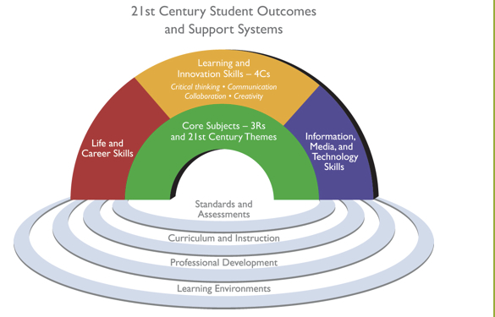
Where does it come from?
Framework for 21st century learning
Learning and Innovation Skills (4 Cs)
Critical Thinking, Communication, Collaboration and Creativity
Notes:
Give out global competency matrix for content areas

Slide 18
Where does it come from?
Kentucky Rising
WHAT? It is a statewide strategic plan focused on a “cradle” to “career” model to improve the economy of the Commonwealth and the prosperity of citizens of the Commonwealth.
GOAL: Kentucky will have a workforce that is among the world’s most highly skilled, globally aware, and globally competent.
METHOD: KY Rising will involve key stakeholders in a working group to develop the statewide cradle to career strategic plan.
TIMELINE: Analysis by March 2015, development by August 2015.
Notes:
Give out global competency matrix for content areas

Slide 19
Where does it come from?
Kentucky Rising
It is not a new initiative or program
It pulls together KY business and higher education partners and state stakeholders in an intentional plan to support Kentucky schools and have every student graduate college career ready.
It supports and intersects with ALL content areas, especially social studies. An emphasis on Kentucky Rising as an intentional focus aligns the rigor of KCAS, PGES, 21st Century Skills and Program Reviews while developing a skilled and highly adaptable workforce.
Notes:
Give out global competency matrix for content areas

Slide 20
What is the Global Competencies Matrix?
The Global Competence Matrix was created as part of the EdSteps project.
It was created by the Council of Chief State School Officers in partnership with the Asia Society Partnership for Global Learning.
It provides detail about the overall definition of Global Competence and how it might be demonstrated by students.
6 content-area matrices with additional information and perspectives relevant to each content area and its objectives.
Provides teachers and students with a way to look at global competence through the different content area lenses.
Notes:
Give out global competency matrix for content areas

Slide 21
Notes:
Give out global competency matrix for content areas

Slide 22
Resources for World Languages
Kentucky Department of Education www.education.ky.gov
NEW!!!
Kentucky Department of Education
World Languages website
http://education.ky.gov/curriculum/conpro/Worldlang/Pages/default.aspx
Notes:
Give out global competency matrix for content areas

Slide 23
Resources for Global Competencies
Kentucky Department of Education website
www.education.ky.gov
NEA Foundation website (former EdSteps website)
www.neafoundation.org
Council of Chief State School Officers website
www.ccsso.org
Asia Society Partnership for Global Learning
www.asiasociety.org
Notes:
Give out global competency matrix for content areas

Slide 24
Resources for 21st Century Skills
Resources for Kentucky Rising
Partnership for 21st Century Skills website
www.p21.org
Partnership for 21st Century Skills: Content Maps
http://www.p21.org/our-work/resources/for-educators#SkillsMaps
Global Competency grade level indicators (Partnership for 21st Century Skills and VIF International)
http://learn.vifprogram.com/indicators
Kentucky Department of Education website
www.education.ky.gov
NEW!!!
Kentucky Department of Education World Languages website
http://education.ky.gov/curriculum/conpro/Worldlang/Pages/default.aspx
Notes:
Give out global competency matrix for content areas

Slide 25
World Language Program Review

Slide 26
Side by side comparison
World Language 2013
World Language/ Global Competency 2014
Dem 1 Student Access: Proficient
The school provides regular opportunities for all students, including heritage speakers, to learn and develop benchmarked proficiencies in at least one world language by scheduling time for instruction, learning opportunities, and monitoring.
Dem 1 Student Access: Proficient
The school provides regular opportunities for all students, including English Language Learners (ELL), to learn and develop benchmarked proficiencies in at least one world language and provide multiple opportunities for all students to experience a range of global cultures, issues and connections (e.g., by scheduling time for instruction, providing resources and monitoring).
Dem 1 School Leadership -Proficient
Leadership selects, implements and evaluates program models designed to meet language proficiency targets and students’ individual needs and college and career readiness goals.
Dem 1 School Leadership -Proficient
School leadership fully implements policies that have been established to ensure that world language and global competency concepts are taught throughout the school and across the curriculum.

Slide 27
Implementation World Language Program Review
High School → Implementation 2014-2015
At the June 4 meeting, the Kentucky Board of Education approved the following plan for the implementation of Program Reviews:
All districts’ high schools will pilot the World Language Program Review (WL PR) in 2014-15, entering information and evidence in ASSIST to set their baseline. High schools will be held accountable for the WL PR in 2015-16.

Slide 28
Implementation World Language Program Review
Elementary & Middle Schools → Implementation 2015-16
Elementary and middle schools will be given the option to choose to use the current World Language Program Review rubric to upload evidences as a 2014-15 “informational pilot”.
They would be using that information to more fully inform program planning and improvements for 2015-16. All entered information could be maintained for the statewide pilot year (2015-16), only updating changes as new evidence is produced. Elementary and middle schools will be held accountable for their WL PRs in 2016-17.

Slide 29
Implementation World Language Program Review
Elementary & Middle Schools → Implementation 2015-16
At a minimum, all elementary and middle schools in 2014-15,
under leadership of school-based decision making councils, will
answer the questions in the World Language Program Review
template in ASSIST but not upload evidences as baseline data.
This provides each elementary and middle school the
opportunity to become more familiar with the rubric, examine
current practices, identify needs, and create a stronger
programmatic improvement plan PRIOR to the required
statewide pilot/baseline setting year.

Slide 30
Implementation World Language Program Review
Elementary & Middle Schools → Implementation 2015-16
These schools also will answer two questions around what
resources (time, training, human, fiscal) are necessary to
implement the program review in 2015-16. This will be key
information that the KDE uses in planning supports for the
successful implementation of this program review.

Slide 31
A joint resolution
KBE and KDE include global readiness as part of the board’s college and career readiness agenda adopted at the August 7th KBE meeting
Minimum standards are set for student achievement to prepare students for college and or a career
1
The challenge is to prepare students for when they graduate; to succeed in college, enter the workforce or the military and participate actively in civic life
2
Citizenship is not just about making informed choices in local, state and national issues; but about having the tools, understanding to engage in global issues and interests
3
A strong system of education enhances the student, and the economic viability of the community, region and state increasing Kentucky quality of life.
4
Many jobs and services in Kentucky are global, increasing the need for both skilled workers who can navigate cultural differences in order to be successful
5
Notes:
August 7th Board meeting
The commitment supports a world class educational system and within that system, strong SS standards and support for world language and gloobal competency program reviews.

Slide 32
It is not about getting kids comfortable with where they are, but where they are going to be in 20-30-40 years
World class education
Experiences in collaboration
Knowledge of other cultures, diversity of thought
World focus rather than a local focus
Knowledge of interconnected world economies and markets
Ability to be competitive world-wide
Knowledge that career and jobs may exist across town or across oceans

Slide 33
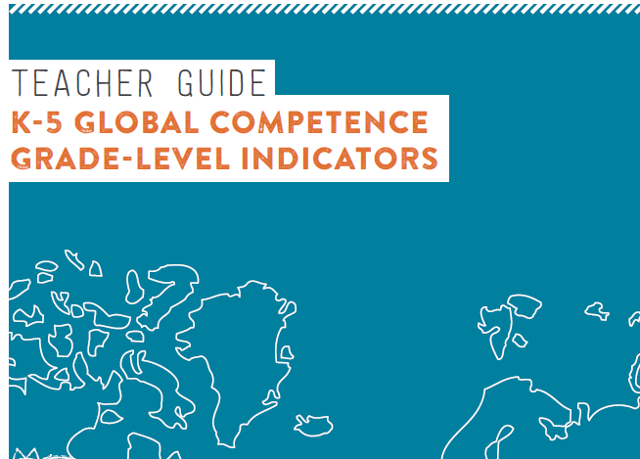
How do we know we are there?
RESOURCES
World Savvy
VIF Global Gateway
Project Explore
US Global Competence.org
Global Ed.org
IREX
EdSteps
Global Nomads
The Exchange 2.0 Coalition
GNG pulse programs
Globalteachereducation.org
KET World Language Toolkit
Global Competence Grade level indicators

Slide 34
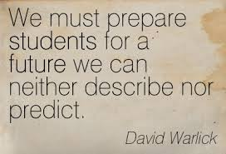

Slide 35
World Languages / Global Competence
Alfonso De Torres Nunez, World Language Consultant
Alfonso.detorresnunez@education.ky.gov
Robert Duncan, Arts & Humanities Consultant
Lead consultant Program Reviews
Robert.duncan@education.ky.gov
Kelly Clark, lead consultant Global Competency
Kelly.clark@education.ky.gov

