Slide 1
Social Studies Network Update Debbie Waggoner
www.debbiewaggoner.com
CKEC Social Studies Network
Meeting - Mon. Nov. 24th
Next Social Studies
Meeting – Tues. Feb. 24th

Slide 2
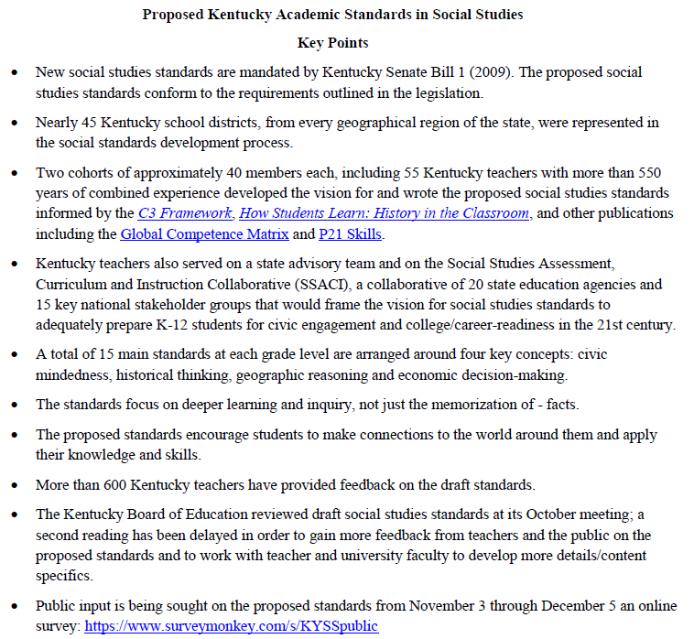
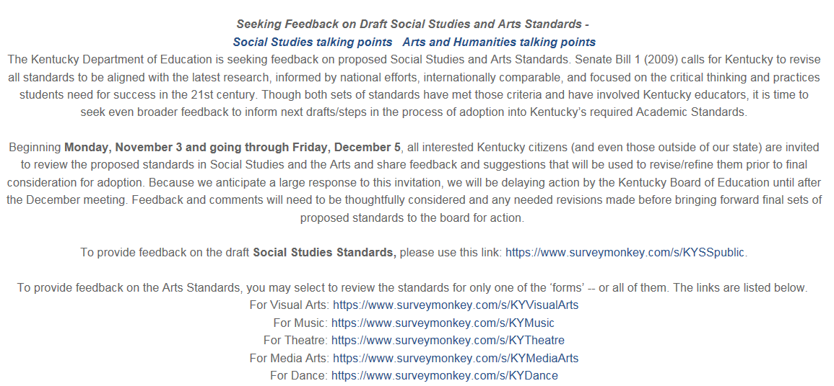

Slide 3
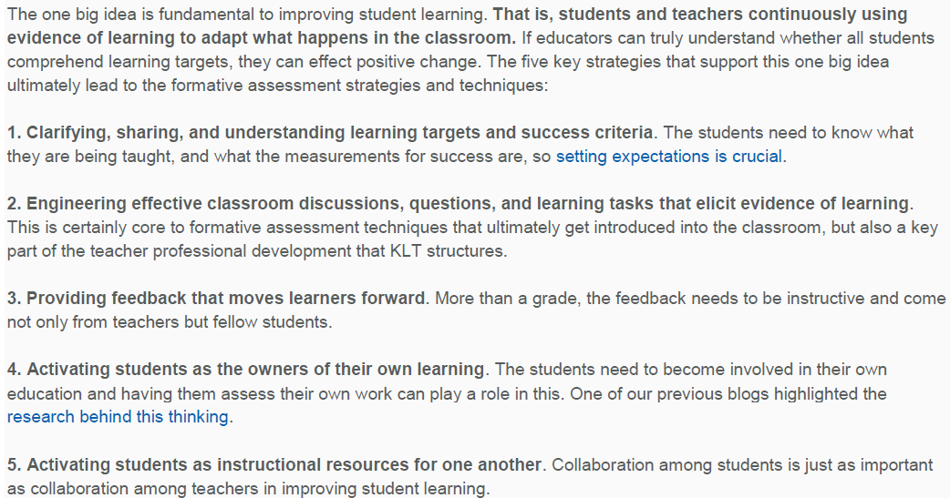
Five Key Strategies of Formative Assessment

Slide 4
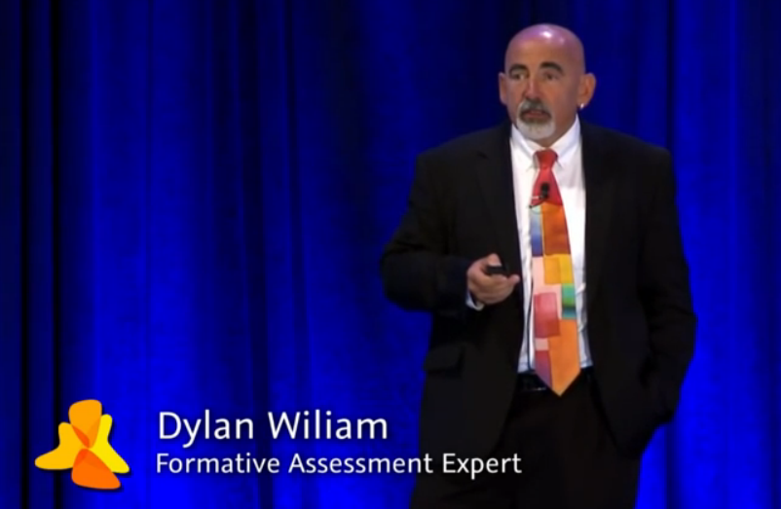
Unpacking Formative Assessment
http://youtu.be/kPf0nQFfv50?list=UUmdB7jO3Yr2wV_qDmiXj3tQ

Slide 5
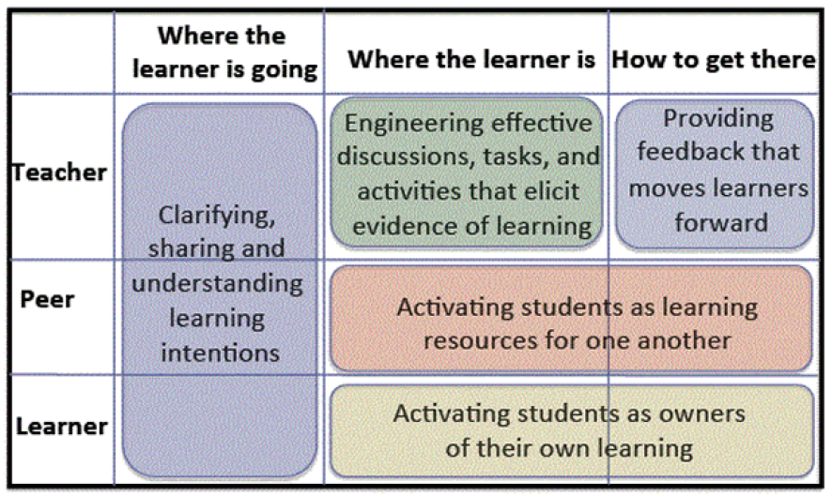

Slide 6
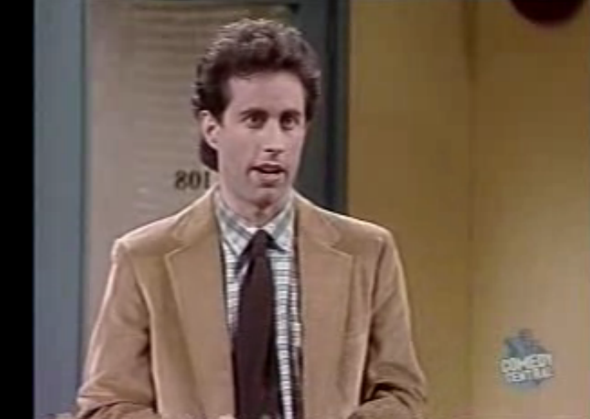
Questioning and Discussion as Formative Assessment
http://www.teachertube.com/video/seinfeld-history-lesson-241598

Slide 7
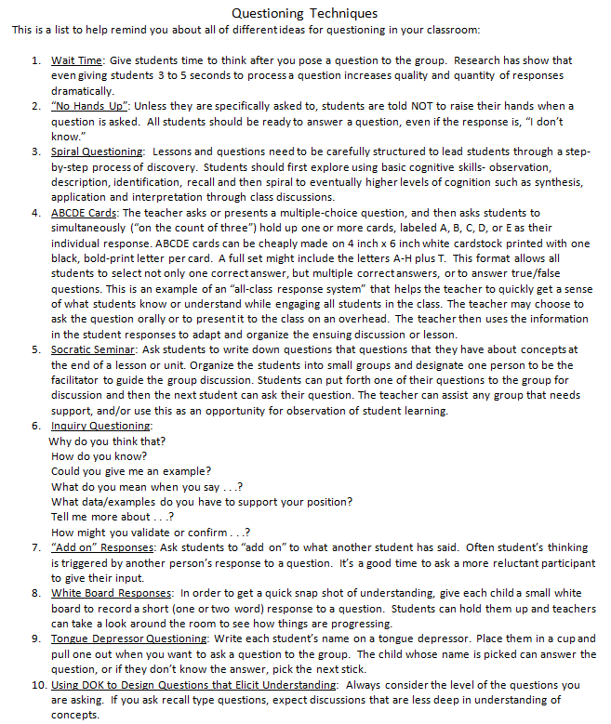
Questioning Techniques
The focus of these techniques is to gather
the most possible information about
what your students know and don’t know.
Having this information about your
students can guide your instruction
as immediately as is practical!

Slide 8
Growing A Teacher’s Own Student-Growth Evidence ~James Popham
“teachers can grow defensible evidence of student growth by relying on teacher-made classroom assessments. But teachers need to learn how to build tests that accurately measure such growth—and how to administer and then score those tests so the world believes what they say”

Slide 9
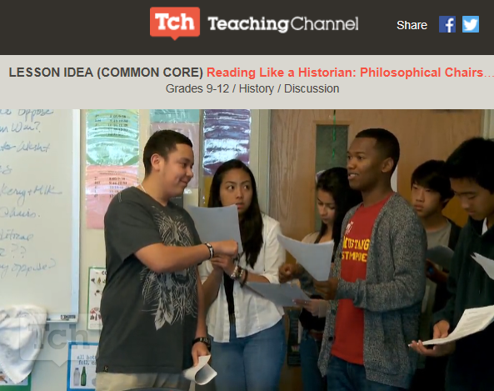
Reading Like a Historian: Philosophical Chairs
Teacher Says… | Student Says…
Teacher Does… | Student Does…
http://fw.to/uNHGwDg

Slide 10
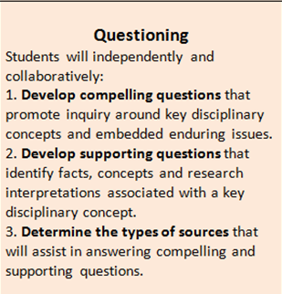
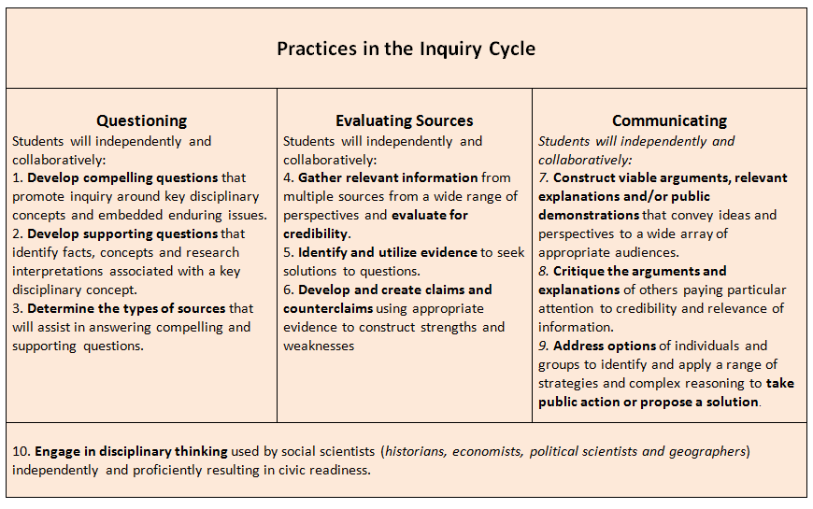
Focus on Inquiry enhances classroom practice…

Slide 11
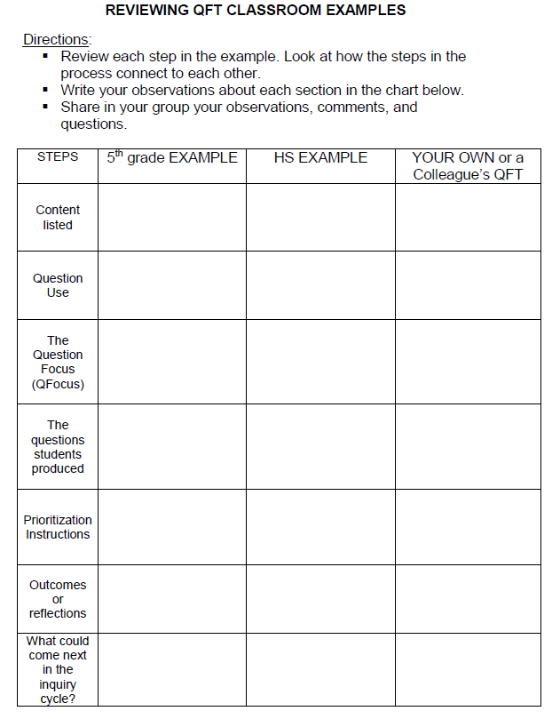
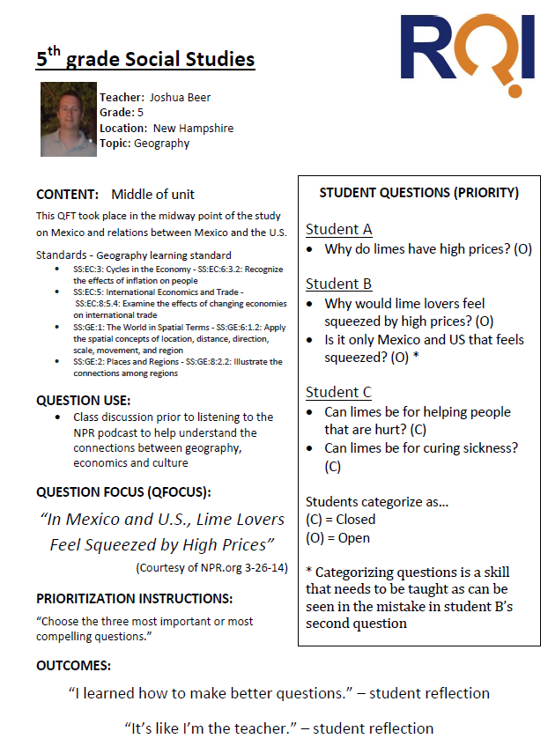
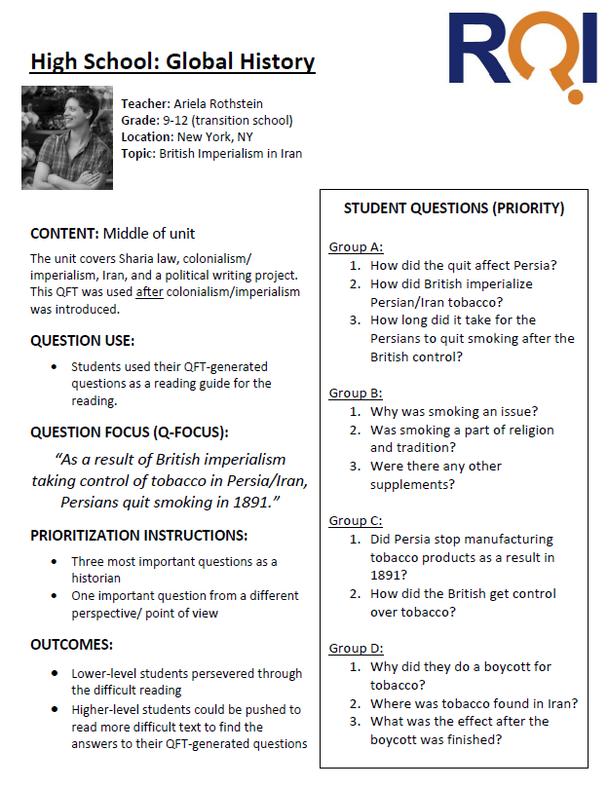
Reviewing QFT Classroom Examples

Slide 12
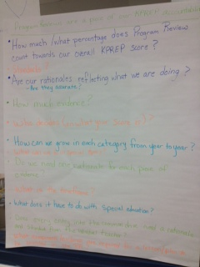
Cindy Phelps posted in Edivation on November 5, 2014
"As an Instructional Coach, I work with teachers on a wide variety of topics and decided to model this strategy as I worked with teachers (some new to the profession, content, school, etc. & some veteran teachers) in groups regarding Program Reviews. I posted the following QFocus to begin the discussion: Program Reviews are an important piece of our KPREP assessment. It was very informative for me to see the variety of questions generated, and it helped guide the direction I needed to go with both small groups and the group as a whole."
Program Reviews are a piece of our KPREP assessment
How much/what percentage does Program Review
Count towards our overall KPREP score?
Standards?
Are our rationales reflecting what we are doing?
Are they accurate?
How much Evidence?
Who decides (on what your score is)?
How can we grow in each category for year to year?
Do we need one rationale for each piece of evidence?
What is the timeframe?
What does it have to do with special education?
Does every entry into the common drive need a
rationale and standard from the initial teacher?

Slide 13
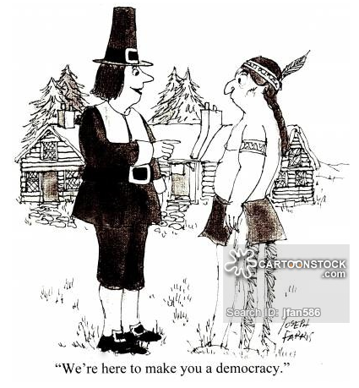
Is it a choice?
Is this a parallel with Iraq and Afghanistan?
Was that really the pilgrims’ intention?
Does the Indian have anything to say about this?
Why does the pilgrim look so optimistic?
Does the pilgrim know what system these folks are currently using? Does the pilgrim care?
Does the Indian understand what the pilgrim is saying?
Would it matter either way?
Does he know what democracy means?
Is that a veil for some other purpose?
Who gets to vote?
Does he have a choice in the matter?
Will they take his choice under consideration?
Question
FOCUS
COMPELLING QUESTIONS:
Democracy serves whose interests?
What does “democracy” mean?
Is democracy always fair?

Slide 14
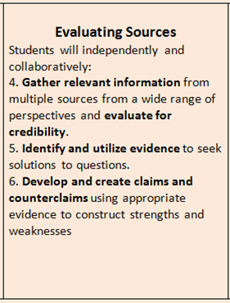
Focus on Inquiry enhances classroom practice…

Slide 15
Crack the Case: History's Toughest Mysteries How do we develop and support theories about historical events using primary and secondary research sources? What is one of the great unsolved mysteries of history? Why do you think people remain so interested in this mystery?
http://preview.opb.org/stage/national_productions/HDSI%20Website/Cracking%20History%E2%80%99s%20Cold%20Cases%20reproducible.pdf

Slide 16
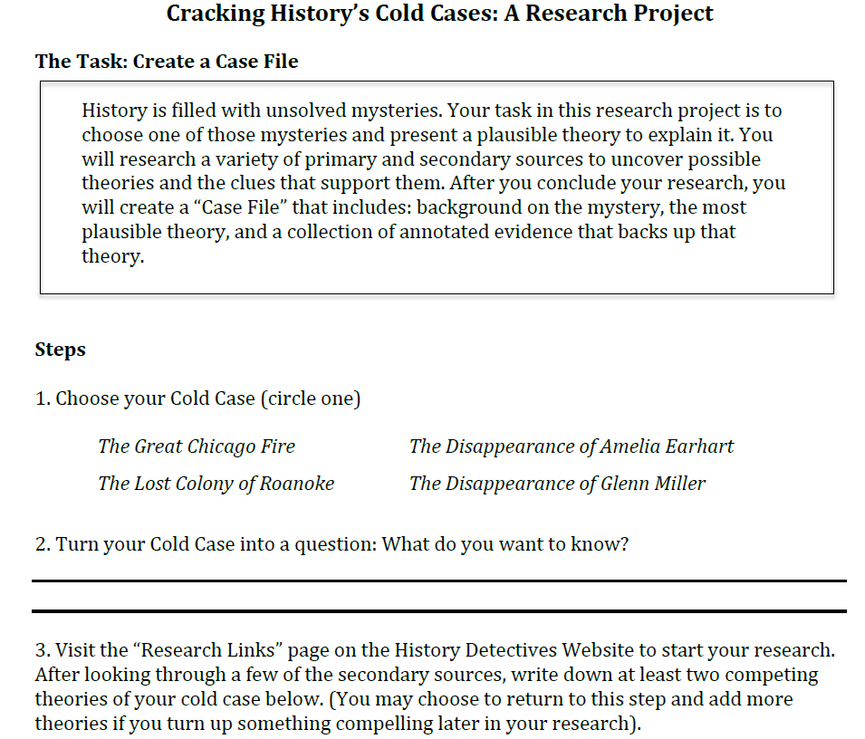
How does this lesson connect to the new content standards in your grade band?

Slide 17
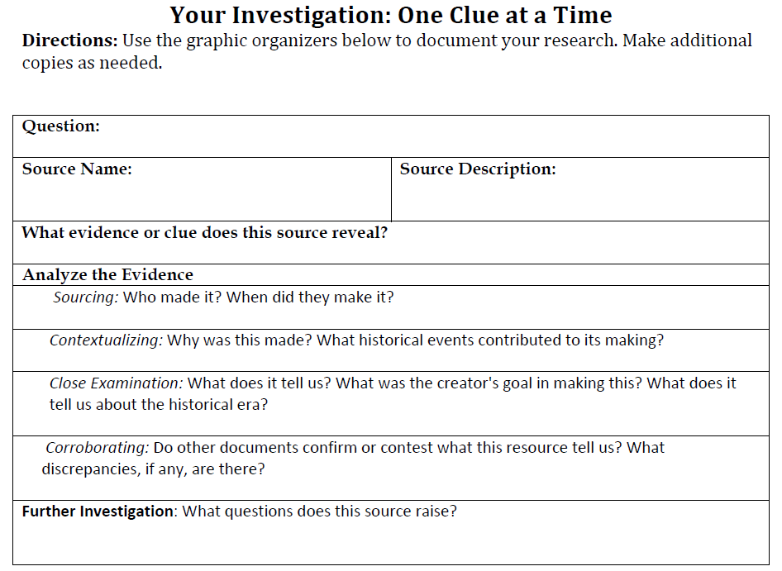
Review Reading Like a Historian

Slide 18
Focus on Inquiry enhances classroom practice…

