Slide 1


How have you seen Surprise & Delight in your school/district this year?
www.todaysmeet.com/CKECISLN
Discuss at your table & summarize
your ideas on Today’s Meet.

Slide 2



CKEC ISLN
January 2013

Slide 3

Pillars again
YEAR 3
Refining Implementation
& Sharing…
Highly Effective Teaching and learning
Kentucky’s Core Academic Standards
Assessment Literacy
Leadership
MathFALs
Cognitively Demanding Tasks
Literacy Design Collaborative
Engineering Student Discussions
Text
Complexity
TPGES –Teacher Professional Growth and Effectiveness System

Slide 4
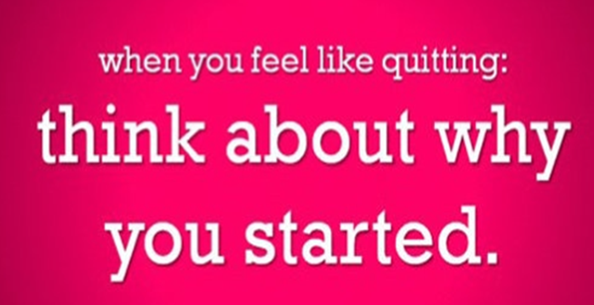

Look How Far We’ve Come!
Keep On Keeping on....
http://www.youtube.com/watch?v=YqlQS5CCmwI
Notes:
We’ve all experienced hardships while implementing the common core BUT everyone is stronger and better teachers because of it!

Slide 5

Learning Target
I can……… .
Analyze where you and your school/district is with balanced assessment and your next steps.

Slide 6
Today’s Agenda
ISLN Materials:
debbiewaggoner-ckecmath.weebly.com/jan-isln.html
Whole Group: | Assessing Our Assessment Literacy – Connecting the Dots
Three Concurrent Sessions:
 | TPGES Front Room
 | Math Update Main Room
 | ELA Update Side – Hallway
Complete Evaluation & Survey

Slide 7
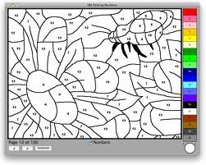
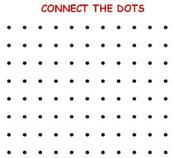
There are two strategies for your life and career. One is PAINT-BY-NUMBERS, and the other is CONNECT-THE-DOTS puzzle. So with paint by numbers set, you know ahead of time what it is going to look like. By contrast with a connect-the dots puzzle, you can only guess at what it might look like by the time you finish.
Mark Templeton
CEO of Citrix

Slide 8

PAINT-BY-NUMBERS | CONNECT-THE-DOTS
How? | Why?
Ends are predictable | Ends are uncertain
Means prescribed by ends | Means interpreted by ends
Knowledge is stable | Knowledge is generative
Teaching is learning techniques | Teaching is reflective on practice
Add on programs/techniques | Integrated programs/techniques
You know that you are painting by numbers when the system is taking you over
Alan Jones, KLA Presentation - Nov. 2012

Slide 9

Do you have a
“Paint by Numbers” or “Connect the Dots” leadership approach to Assessment Literacy?
Discuss at your table & summarize
your ideas on Today’s Meet.

Slide 10
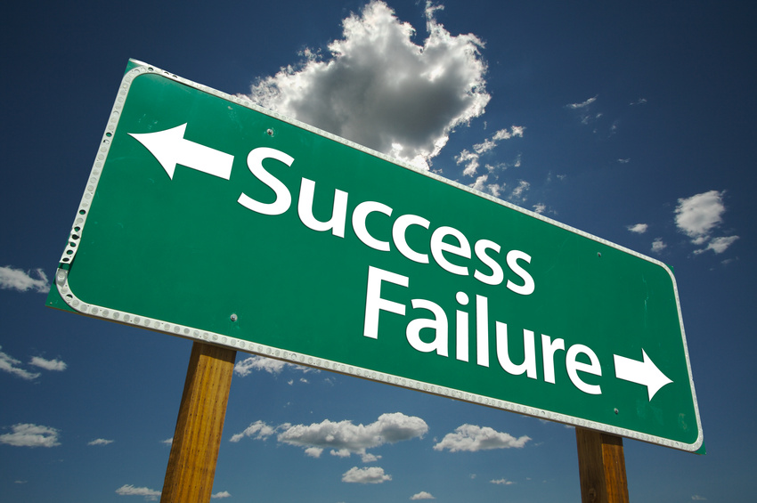
Assessment Literacy:
Seven Actions to Ensure
Student Success
--Balance the District’s assessment system to meet all key user needs.
--Refine achievement standards to reflect clear and appropriate expectations at all levels
--Ensure assessment quality in all contexts to support good decision making.
--Help learners become assessors by using formative assessment (assessment for learning) strategies in the classroom.
--Build communication systems to support and report student learning
--Motivate students with learning success.
--Provide professional learning needed to ensure a foundation of assessment literacy throughout the system.
Assessment Balance and Quality An Action Guide for School Leaders
Chappuis, Commodore, Stiggins
Packet
pages 17-28

Slide 11
Formative Assessment | Summative Assessment
It’s a Process! A way of using assessment to increase student achievement | It’s a thing! An assessment given to identify what students know
Provides practice Allows teachers to determine next steps during the learning process based on information learned Involves students as assessors of their own learning and as resources to other students Provides students with descriptive feedback to help them improve | State assessments District benchmark or interim assessments End-of-unit or chapter tests End-of-term or semester exams Scores that are used for accountability for schools and students (report card grades).
Used to inform instruction | Used as a gauge student learning relative to content standards
Occurs during instruction | Occurs after instruction
Process allows teachers and students to make adjustments so that students can be successful | Tools to help evaluate the effectiveness of programs, school improvement goals, alignment of curriculum, or student placement in specific programs

Slide 12
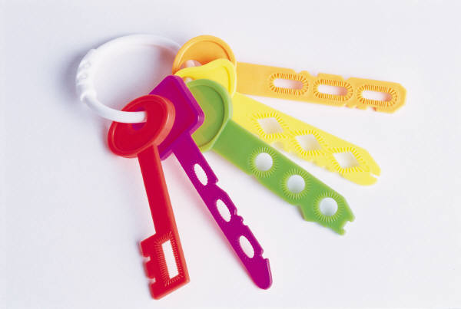
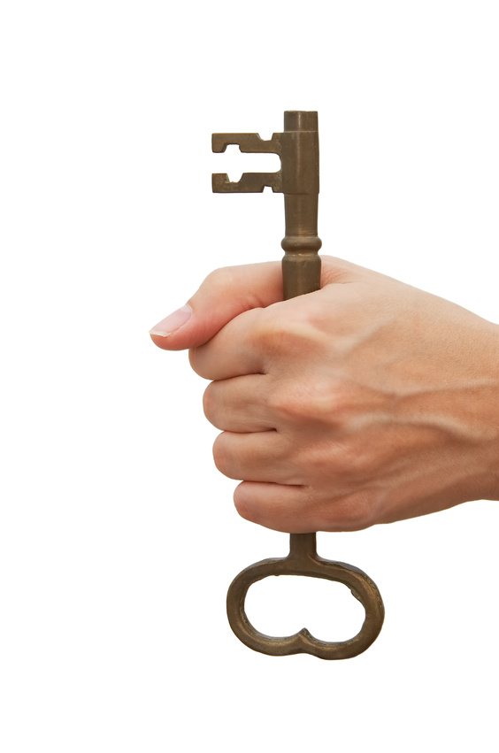
Five “Key Strategies” for Effective Formative Assessment
Clarifying, sharing, and understanding goals for learning and criteria for success with learners
Engineering effective classroom discussions, questions, activities, and tasks that elicit evidence of students’ learning.
Providing feedback that moves learning forward.
Activating students as owners of their own learning.
Activating students as learning resources for one another.
Notes:
Look at Five “Key Strategies” for Effective Formative Assessment.

Slide 13

Formative Assessment Vignettes
1 - Distribute the 12 vignettes at your table.
2 - Each person read their own vignette(s).
3 - Share what you have read.
  Start with vignette #1 – the person who read this vignette briefly summarizes the vignette for the group and key formative assessment strategies it exhibits.
  Allow each person 1-2min per vignette.
Reflection:
Which of these formative practices do you see in your school(s) now?
How will you use these vignettes with your administrators & teachers?
Packet
pages 11-16
Discuss at your table & summarize
your ideas on Today’s Meet.

Slide 14

Balanced Assessment Systems:
Three Types of Assessments
Classroom Assessment
Benchmark/Interim Assessments
State Assessments
Packet
pages 5 - 7

Slide 15
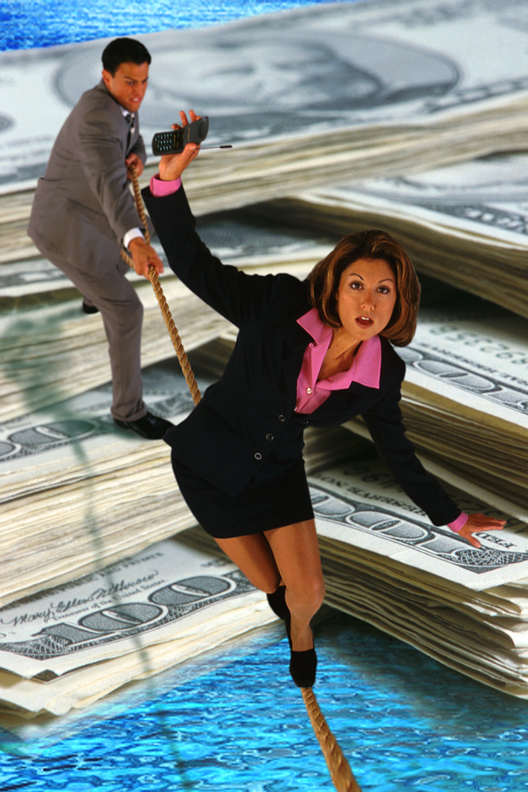
Are You Balanced?
--Divide into 3 small groups from your district.
--Each group take one of the assessment
types:
  Classroom Assessment
  Benchmark/interim
  State Assessment
--Read the Formative/Summative Applications
and identify what you currently have in place to support that assessment.
--When ready discuss as a district – add based on your discussion
Packet
pages 5 - 7

Slide 16

One More Step- Self Evaluation
Action One: Balanced Assessment System
Review the Self Evaluation for Action One
As a district group discuss where you are as a district for each of the competencies.
While you discuss be talking about your next steps in creating a balanced assessment system within your district.
If you have time, go to Action Two and continue your self evaluation.
Packet
pages 19-21

Slide 17

To be continued back in your district…..
Packet
pages 19-21
Complete the self evaluation
As a school or district are you where you want to be in Assessment Literacy?
Once you know where you are identify the next steps---think about…
“Connecting the Dots” with your assessment.
Discuss at your table & summarize
your ideas on Today’s Meet.

Slide 18

Some things to remember…..
Formative Assessment is supported by research:
  Marzano - one of top 10 strategies
  Black and Wiliam – shows conclusively that formative assessment does improve learning
  Hattie – Feedback has one of the highest effects on student learning

Slide 19
Some things to remember…..
Focus on Feedback
Read the 4 pieces of information about feedback.
As a group discuss:
  What does this reinforce about what you know about feedback?
  Any different ideas?
Packet
page 7

Slide 20

Some things to remember…..
Student Growth goals will require effective assessment systems within schools and districts.

Slide 21
Some things to remember…..
A new generation of Assessments are being created:
PARCC –
  http://www.parcconline.org/parcc-assessment
Smarter Balance
Packet
pages 8-9

Slide 22


Where are you as a leader?
Packet
page 10
Take a few minutes to complete the self assessment

Slide 23
IMPORTANT UPCOMING DATES:
HOLD THE DATE:
  National Speaker Eric Jensen will be speaking at NorthEast Christian Church on Wed., March 6th sign-up for the
  morning session: Tools for Engagement or afternoon session: Discoveries from Brain Research or both at: http://www.cksec.org/OnlineReg/
DATE CHANGE:
March CKEC ISLN will now be on WEDNESDAY, March 20th –NECC requested this change, so please change it in your calendars!
HOLD THE DATE:
SUMMER Joint ISLN/KLA statewide meeting will be WED. & THURS. June 26th & 27th at Lexington Center – more details to come!

Slide 24
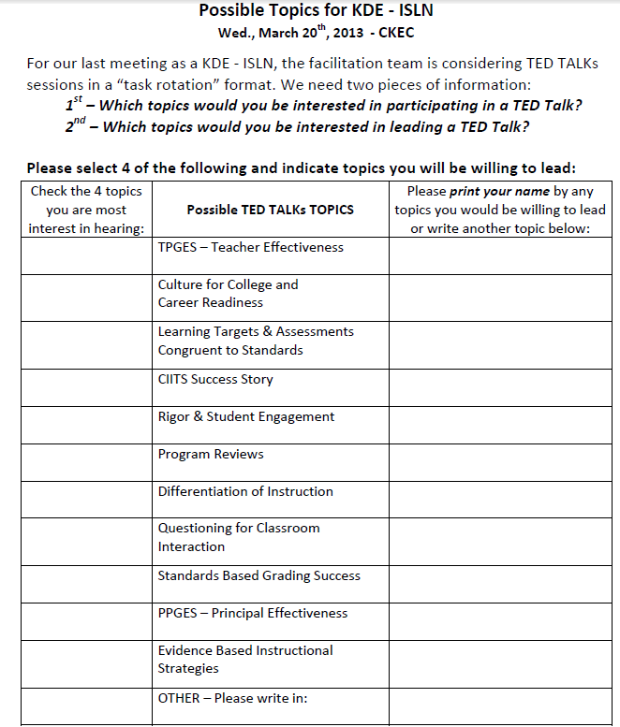
CKEC- ISLN Wed. Mar. 20th
TOPICS for TED Talks
SURVEY

Slide 25
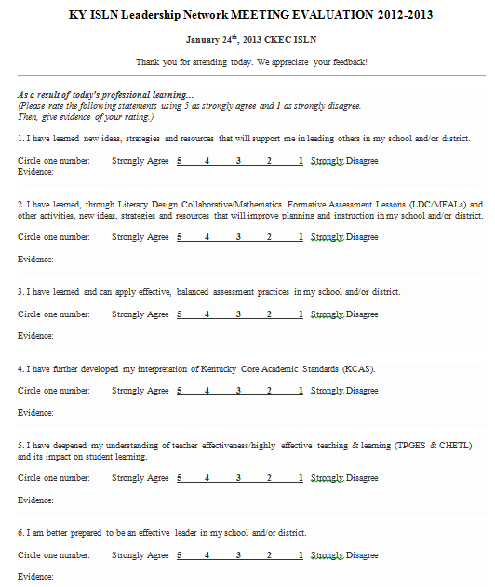
EVALUATIOn Online Version available at:
http://debbiewaggoner-ckecmath.
weebly.com/isln-evaluation.html
EVALUATION

Slide 26
How can we help you?
Char Williams,
KLA Consultant
Debbie Waggoner,
Math Content Specialist
Kelly Philbeck,
ELA Content Specialist
Becky Woosley,
Effectiveness Coach

Slide 27
Concurrent sessions
 | Districts: | Districts: | Districts:
 | Anderson, Bardstown, Bourbon, Boyle, Burgin, Clark, Danville, Fayette | Frankfort, Harrison, Jessamine, KSD, Marion, Mercer, Montgomery, Nelson | Nicholas, Paris, Powell, Scott, Washington, Woodford
Session 1 | TPGES Front Room | ELA Update Side – Hallway | Math Update Main Room
Session 2 | Math Update Main Room | TPGES Front Room | ELA Update Side – Hallway
Session 3 | ELA Update Side – Hallway | Math Update Main Room | TPGES Front Room
TURN IN YOUR EVALUATION & SURVEY in the 3rd SESSION!

