Slide 1
CKEC Social Studies Content Leadership Network
April 21st, 2015
All materials for today’s meeting can be found at
http://www.debbiewaggoner.com/apr-2015-social-studies.html

Slide 2
CKEC Social Studies Facilitation Team
Debbie Waggoner, KDE/CKEC Social Studies Instructional Specialist
Laura Smith, Instructional Coach, CKEC/CKSEC
Terry Rhodes, KDE/CKEC Science Instructional Specialist
Krista Hall, KDE Instructional Consultant
Maurice Chappell,
Director of Implementation & Innovation,
Jessamine County Schools
Rebecca Mueller,
Doctoral Student, University of Kentucky
Today’s materials can be accessed at: www.debbiewaggoner.com/apr-2015-social-studies.html

Slide 3
Learning
Teaching
Enhancing
Supporting
Sharing
Burgin Independent School
Over 100 years of Excellence

Slide 4
PGES - Professional Growth and Effectiveness System

Slide 5
GREEN
SHEET

Slide 6
Norms:
Respect
Cell phone
Engagement
Restrooms
Being Prepared
Side Conversations
Use Technology to enhance your day

Slide 7
Social Studies Network Meeting IMPORTANT NOTES
PINK Sheet
Notes:
As always, we have your reflection sheet for you to record your thoughts and ideas throughout the meeting.
(Read Reflection questions)

Slide 8
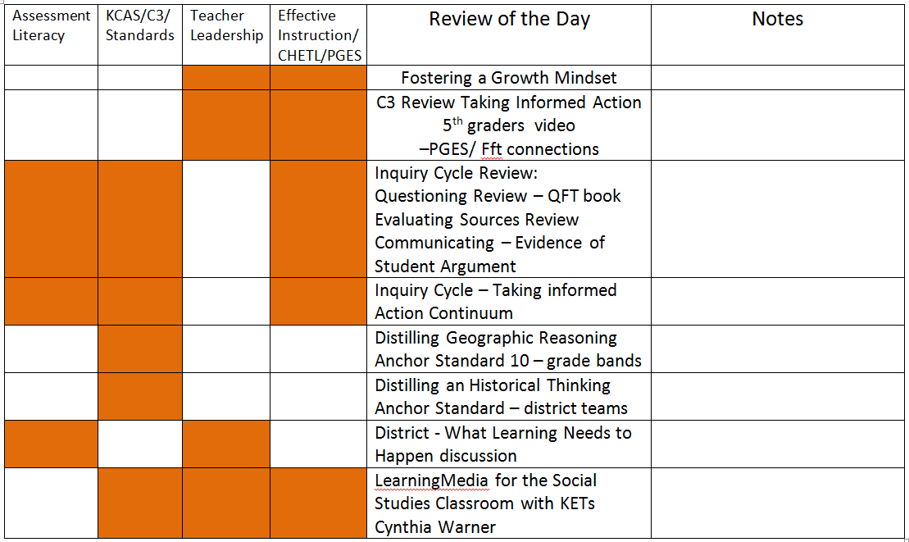
4 pillars connections throughout the day
Back of PINK Sheet

Slide 9
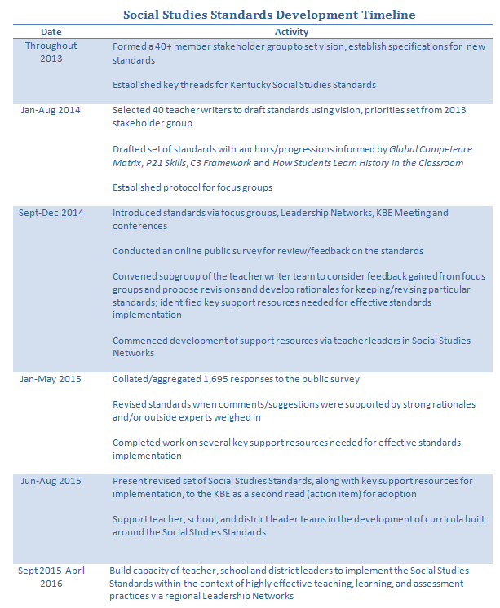
Social Studies Standards Timeline
March 2015
April 2015
Lavender page

Slide 10
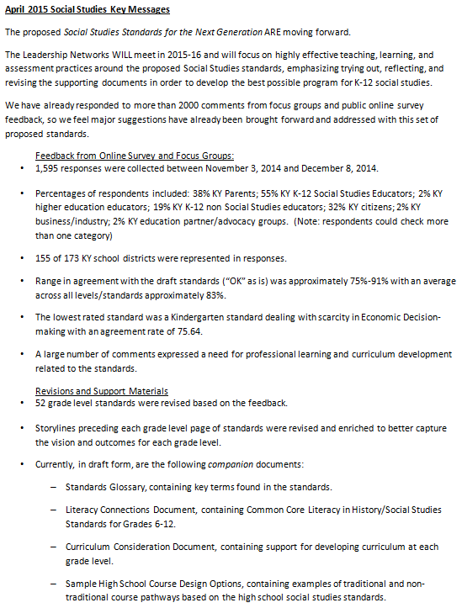
KEY Messages
Lavender page
Feedback
Revisions and
Support Materials

Slide 11
Is your MINDSET FIXED? Do your students know how to learn from their mistakes?

Slide 12
With a partner decide who will read each article on the yellow sheet:
--Don't Prevent Students' Mistakes, Prepare for Them or
--5 Things You Can Do to Encourage a Growth Mindset in Kids
After reading your article be ready to share in 3-5minutes:
Summarize the main points of the article
Discuss how you plan to use growth mindsets to finish out
the year with your students
Discuss how you plan to use growth mindsets this spring
and summer to work with your social studies colleagues.

Slide 13
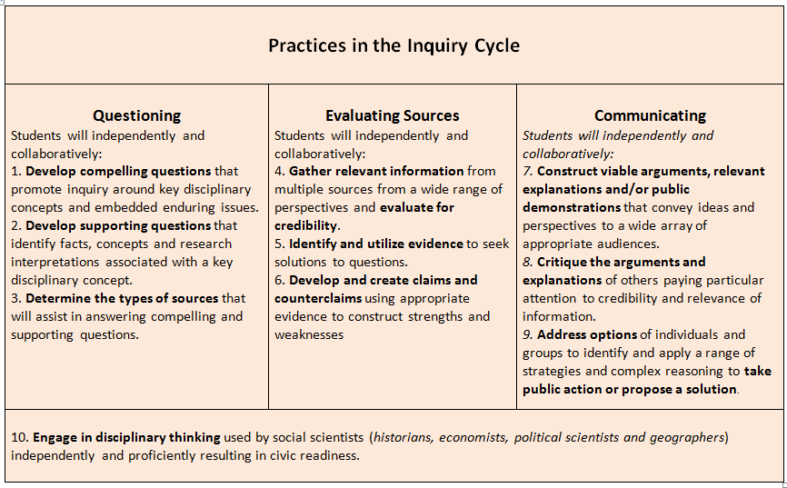

Slide 14
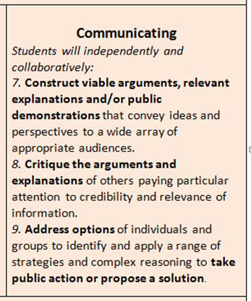
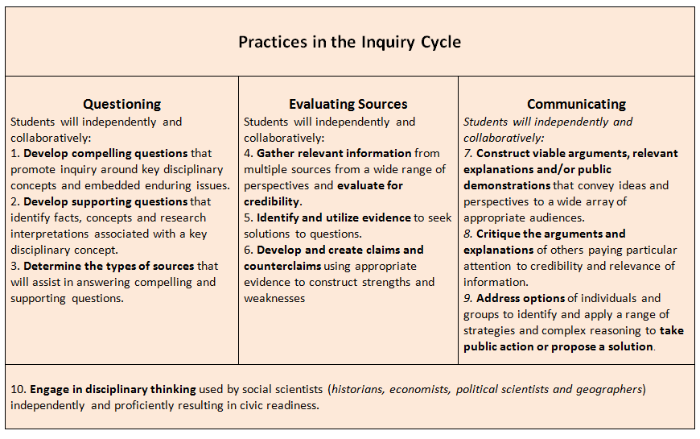
Focus on Inquiry enhances classroom practice…

Slide 15
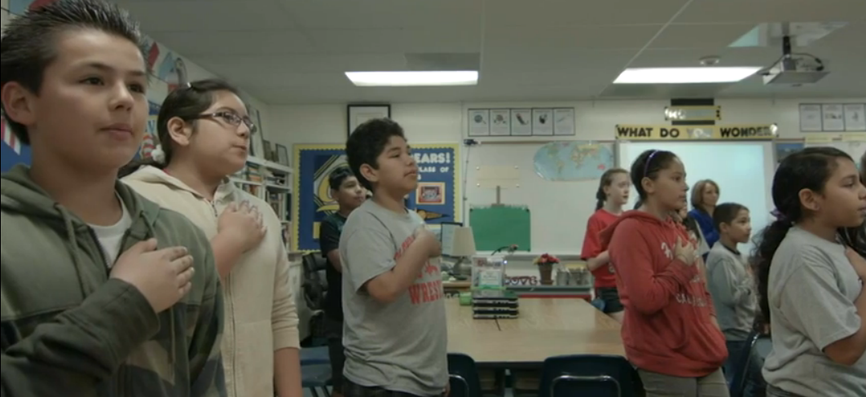
Taking Informed Action
Focus on one page from the Framework for Teaching: 1E, 2B, or 3C while you are watching the video. Look for evidence in the video that corresponds to the page you are reviewing. Make sure all three pages are represented at Your table. Be ready to discuss the evidence you see after the video.
http://youtu.be/ZcYc8o3b4XI
Connecting to CHETL/PGES/Framework for Teaching
Notes:
http://youtu.be/ZcYc8o3b4XI

Slide 16
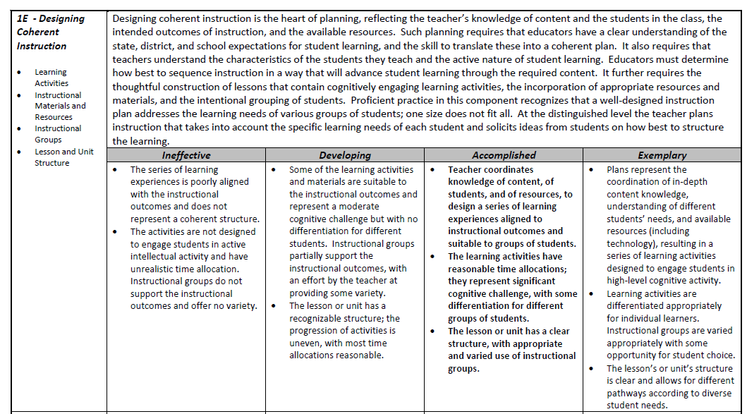
1E Designing Coherent Instruction
Focus on one page from the Framework for Teaching: 1E, 2B, or 3C while you are watching the video. Look for evidence in the video that corresponds to the page you are reviewing. Make sure all three pages are represented at Your table. Be ready to discuss the evidence you see after the video.

Slide 17
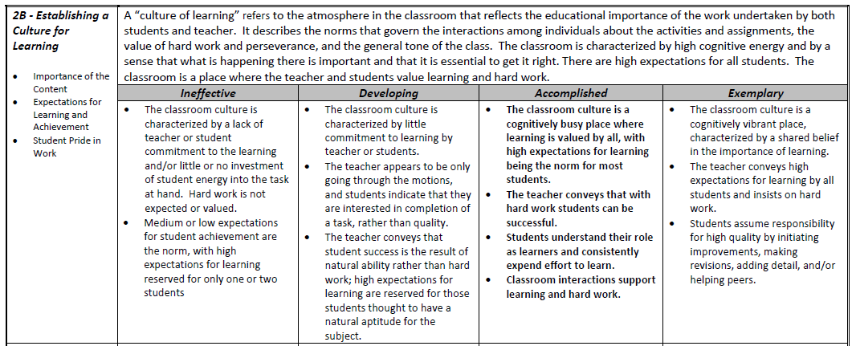
2B – Establishing a Culture for Learning
Focus on one page from the Framework for Teaching: 1E, 2B, or 3C while you are watching the video. Look for evidence in the video that corresponds to the page you are reviewing. Make sure all three pages are represented at Your table. Be ready to discuss the evidence you see after the video.

Slide 18
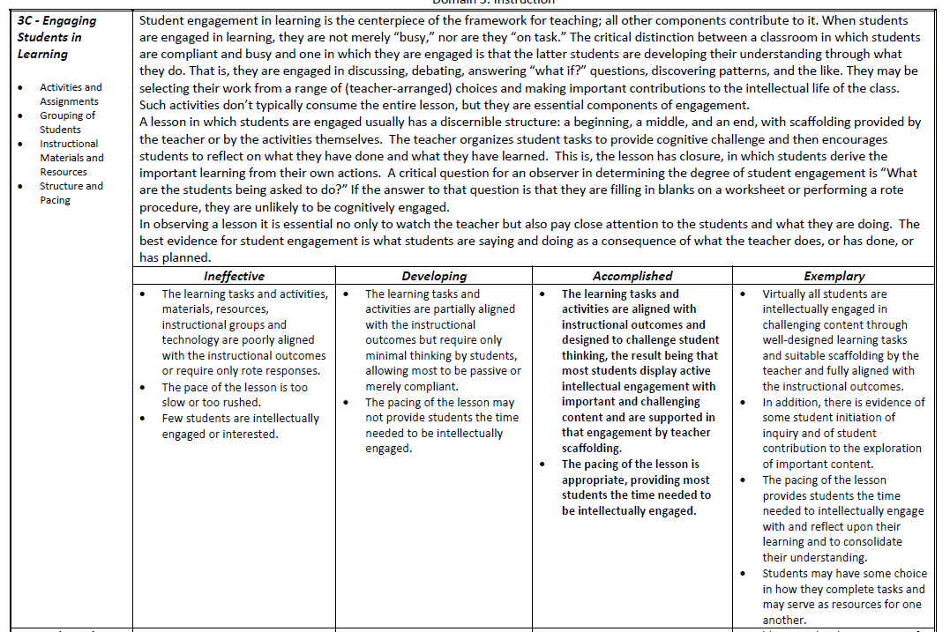
3C – Engaging Students in Learning
Focus on one page from the Framework for Teaching: 1E, 2B, or 3C while you are watching the video. Look for evidence in the video that corresponds to the page you are reviewing. Make sure all three pages are represented at Your table. Be ready to discuss the evidence you see after the video.

Slide 19
In your grade level group rooms
--Review Inquiry Cycle:
QFT, Evaluating Sources, Argument, and
--Complete the Taking Informed Action continuum activity
--Distill the Content for Geographic Reasoning Anchor 10 for your grade band

Slide 20
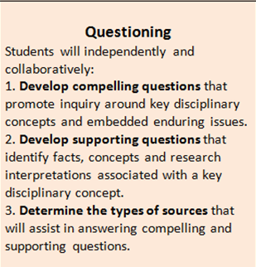
Focus on Inquiry enhances classroom practice…
Grade Level Groups –

Slide 21
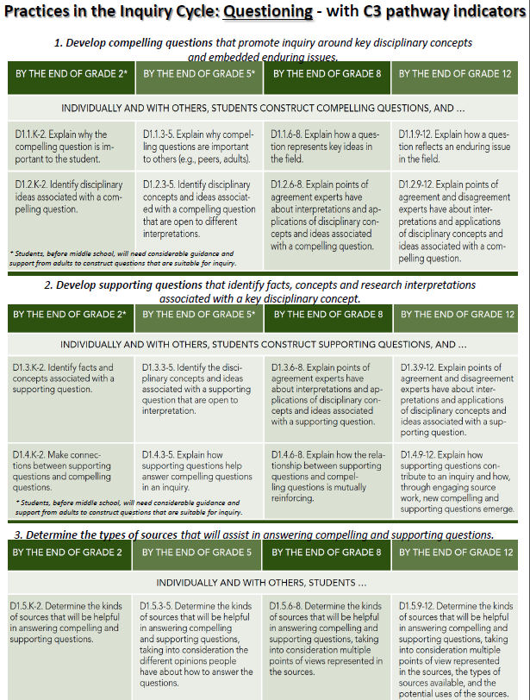
Defensible Evidence of Inquiry Standards 1-3
Grade Level Groups –
Have you had your own students
develop their own questions?
How have you used the QFT to
help with this process?

Slide 22
Grade Level Groups –

Slide 23
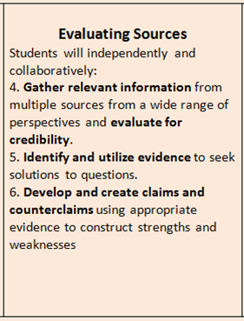
Focus on Inquiry enhances classroom practice…
Grade Level Groups –

Slide 24
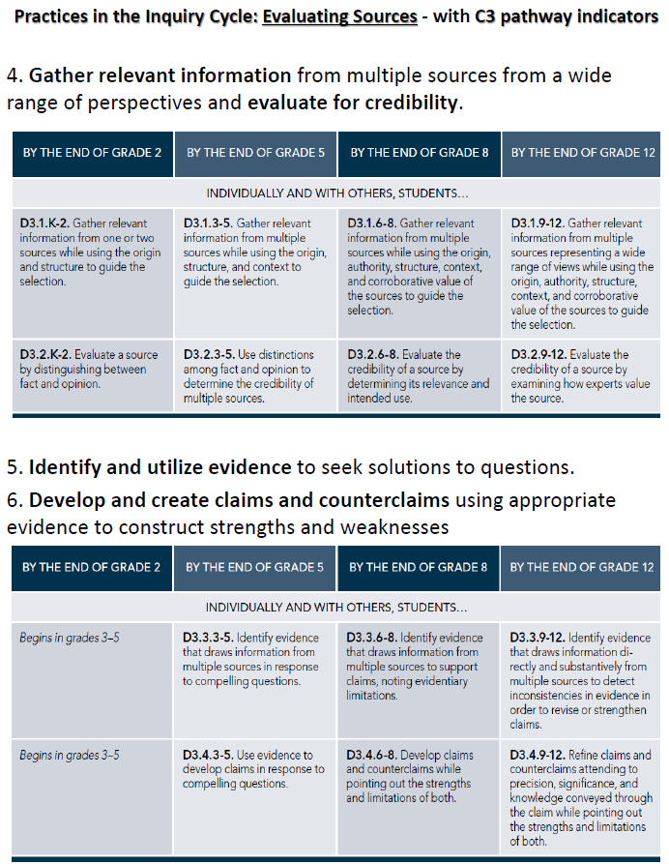
Grade Level Groups –
DEFENSIBLE EVIDENCE of Inquiry Standards 4-6
or have you observed in your students?
How have you had your own
Students evaluate sources and
create claims?

Slide 25
proficient level of “evaluating sources”
Grade Level Groups –
Identify the context written or spoken
Point out any bias in the document
Recognize the purpose
Actually be able to read and/or understand the document
Be able to compare and contrast
Using multiple sources as evidence not just one source
Gather their own sources (depends on grade level) or choose the best sources among a selection of sources
Credibility of the source – primary or secondary source

Slide 26
Focus on Inquiry enhances classroom practice…
Grade Level Groups –

Slide 27
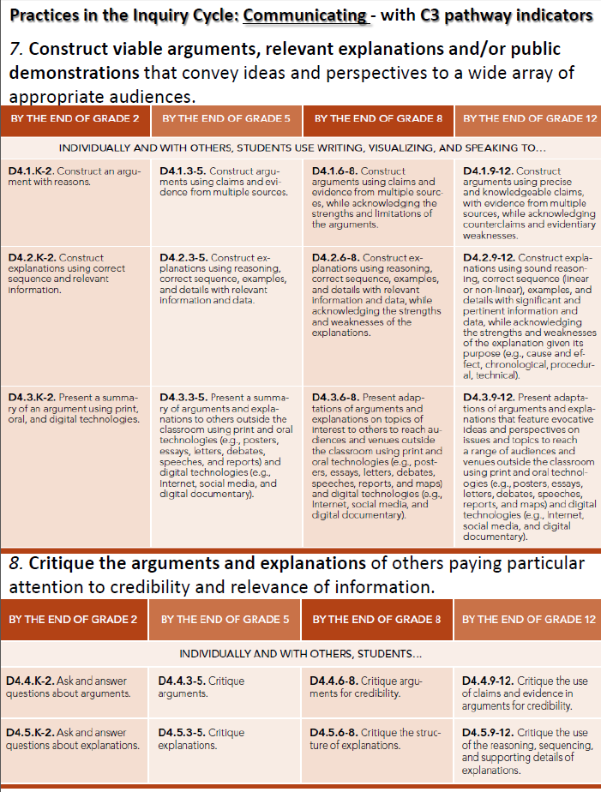
Grade Level Groups –
Defining Defensible Evidence: Mastery of Communicating -
Constructing Viable Arguments and Critiquing Arguments of Others – Inquiry Standards 7-8
What evidence of
argumentation did you find
in your own students’ work?

Slide 28
Mastery of Communicating - Constructing Viable Arguments and Critiquing Arguments of Others
Grade Level Groups –
Is the argument evidence based
Referring to support for their argument as their evidence
Incorporating content vocabulary reflects content understanding
Clear statement of argument
Document based questions are an example
Recognizing and refuting the counter claim

Slide 29
Focus on Inquiry enhances classroom practice…
Grade Level Groups –

Slide 30
Taking Informed Action
Grade Level Groups –
The Inquiry Cycle concludes with Taking Informed Action.
Action can come in many forms and require varying degrees of complexity.
There is no right way. What’s most important is that students have opportunities to act on their learning.

Slide 31
Continuum
Grade Level Groups –
Assuming “organize a rally” is most complex and “create a poster and hang it in a public space” is least complex, work as a group to place the different examples of Taking Informed Action along a continuum of complexity.
As you discuss, if you feel other examples should be the ends of the continuum, feel free to rearrange
This was originally presented at the New York Council for Social Studies Conference. Thanks to Dr. Kathy Swan, Joe Karb, and Steve Lazar for sharing their materials.
Notes:
You can hand everyone a placard and have them make a human continuum, or you can have them organize the placards on the floor/wall
Before beginning, have participants discuss what a student would have to do to make the example at each end of the continuum (rally and poster) happen.

Slide 32
Continuum Debrief
Grade Level Groups –
Notes:
- Quickly read the examples in order from least to most complex
- Questions for discussion:
- Select 1-2 items from the ‘most complex’ end -- What makes this complex? What would you have to do as a teacher to support? What are the advantages of this kind of action? What are some challenges?
Select 1-2 items from the ‘least complex’ end -- What makes this more doable? What are the advantages of this kind of action? What are some challenges?
Where did you put “initiate an informed conversation”? Is this an example of action?
Do you think it’s possible for students to take informed action in your school? What supports to teachers need to make these types of things happen?
What needs to be done to make sure that action is clearly connected to content?

Slide 33
Action Requires Knowledge
Grade Level Groups –
As outlined in the C3 Framework:
Step 1: Understand the problem
Step 2: Assess the problem
Step 3: Take action on the problem
Notes:
Students should build their knowledge and understanding of an issue before engaging in any social action. In the understand stage, students demonstrate that they can now think about the issues behind the inquiry in a new setting or context. The assess stage asks students to consider alternative perspectives, scenarios, or options as they begin to define a possible set of actions. The act stage is where students decide if and how they will put into effect the results of their planning.

Slide 34
Modeling a Protocol for Distilling Content from Standards
Grade Level Groups –
Architecture Study
Anchor
Grade-level Narrative
Grade-level Standard
Context Examples
Connections
REVIEW – short
one-page distilling
Protocol reminder
on the back of your
Agenda (green sheet)

Slide 35
Grade Level Groups –
Use the Distilling Content Protocol to
distill content from all the grade level
standards in your grade band for
Anchor Standard 10.
Each table needs 6 participants.
First work with a partner on a small
sheet, then complete the larger chart
with your table group as you come to
consensus. You have 45min.
Elementary: K-5
Middle School: grades 6-8
High School: HS1, HS2, HS3, HS4

Slide 36
Please sit with your district team
**DEBRIEF**
Whole Group Sharing of
Geography Anchor 10
K-12 Progression
--Grades K-5 teachers share at your district tables
What can we say about this Anchor Standard
in the elementary grades?
--Grades 6-8 teachers share at your district tables
What can we say about this Anchor Standard
in the middle school grades?
--Grades 9-12 teachers share at your district tables
What can we say about this Anchor Standard
in the high school grades?

Slide 37
One SET per DISTRICT:
K-2 CCD
3-5 CCD
6-8 CCD
HS CCD
REVISED STANDARDS MARCH 2015

Slide 38
Distill a Historical Thinking Anchor with your
District Team Table Group
At your table distill the content from the
History Anchor your table has been assigned.
Follow the sample protocol of working with a
partner to complete the small chart first then as
a table complete the larger chart as you come
to consensus.

Slide 39
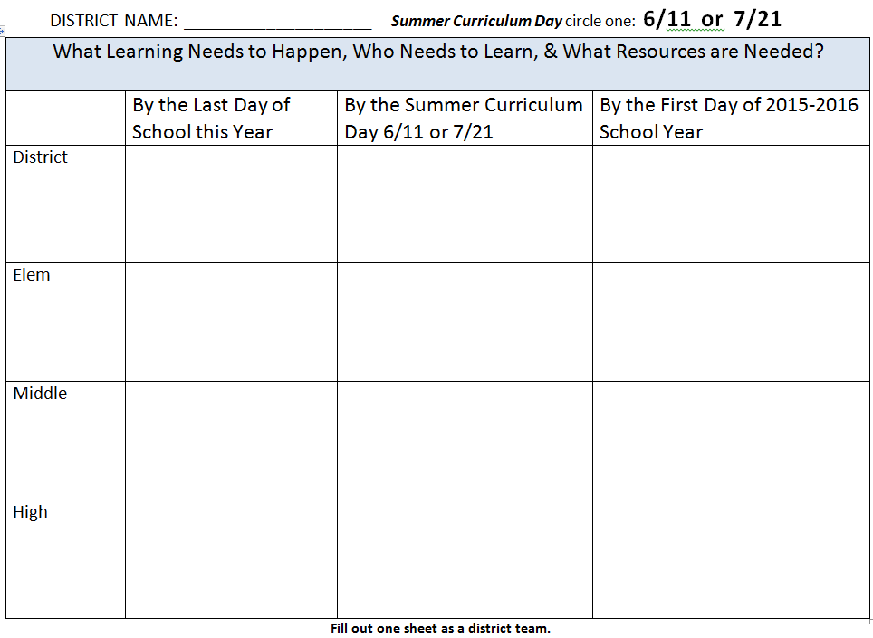
Complete one BLUE sheet with your DISTRICT TEAM
Review your
Individual BLUE
sheets from
March and make
adjustments as
needed for one
DISTRICT form
this month
What capacities are in place to make curricula decisions?
How do we prepare our district, school, and team to write SS curriculum?

Slide 40
CKEC Summer SS Network
Thurs. June 11th | Tues. July 21st | Thurs. July 23rd
Curriculum Planning Day | Curriculum Planning Day | Joint Science and Social Studies LDC Day
When is your district team
going to attend?
Who will you include on your district team?
Plan to focus on planning inquiry based units to try out and start implementing for the upcoming year.
What other needs does your district have for the time we spend together on these dates?

Slide 41
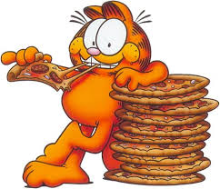
Lunch

Slide 42
LearningMedia for the Social Studies Classroom
with KET’s Cynthia Warner
CWarner@ket.org

Slide 43
Review of the day:
4 pillars connections throughout the day
Please complete the online evaluation
before you leave. We need your feedback!

Slide 44
We hope you will join your district teams for our summer sessions:
Social Studies Curriculum Planning: June 11th or July 21st
FYI - Science Curriculum Planning: June 10th or July 16th
Joint Science and Social Studies LDC Day: July 23rd
Mark it now KCSS Sept 29-30
Erlanger, METS Center
Have a great end of the school year, and a
wonderful summer! Call us for your professional
learning needs ASAP, our calendars are filling up fast.
Thanks for a great 2014-2015 year with the
CKEC Social Studies Teacher Leader Network!

